Slide 1
Introduction to Data Visualization and Best Practices
Richard Johansen
June 18th 2018

Slide 2
Workshop Agenda
Introduction to Data Visualization
Why We Visualize
Understanding Data
Visualizations
Tools and Software
Visualization Design and Best Practices

Slide 3
Workshop Agenda
Introduction to Data Visualization
Why We Visualize
Understanding Data
Visualizations
Tools and Software
Visualization Design and Best Practices

Slide 4
What is Data Visualization
“Visualization transforms data into images that effectively and accurately represent information about the data.”
–Schroeder et al. The Visualization Toolkit, 2nd ed. 1998
“Data graphics visually display measured quantities by means of the combined use of points, lines, a coordinate system, numbers, symbols, words, shading, and color.”
–Edward Tufte The Visual Display of Quantitative Information (2nd Ed.)

Slide 5
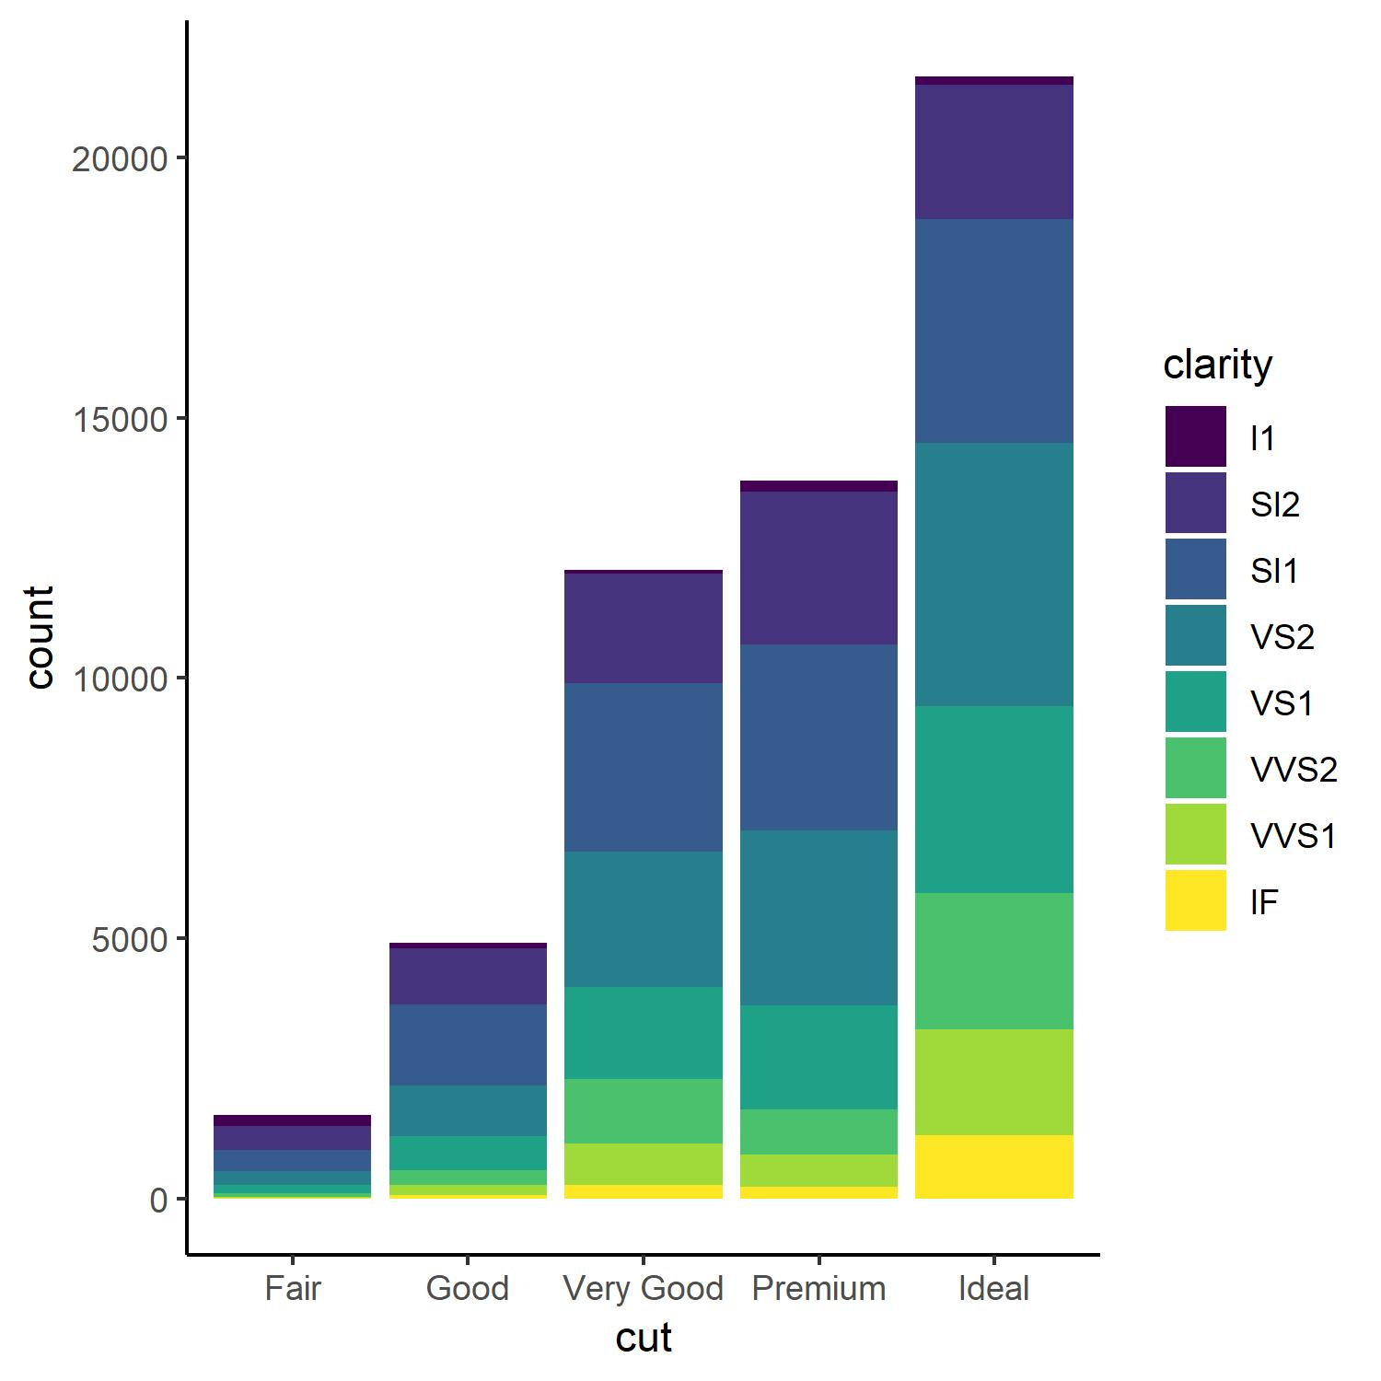
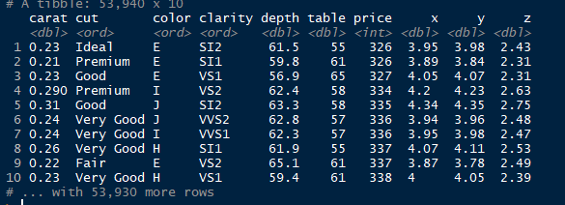
Why is Data Visualization Important?
A picture is worth a 1,000 words (observations)
–Tess Flanders 1911

Slide 6
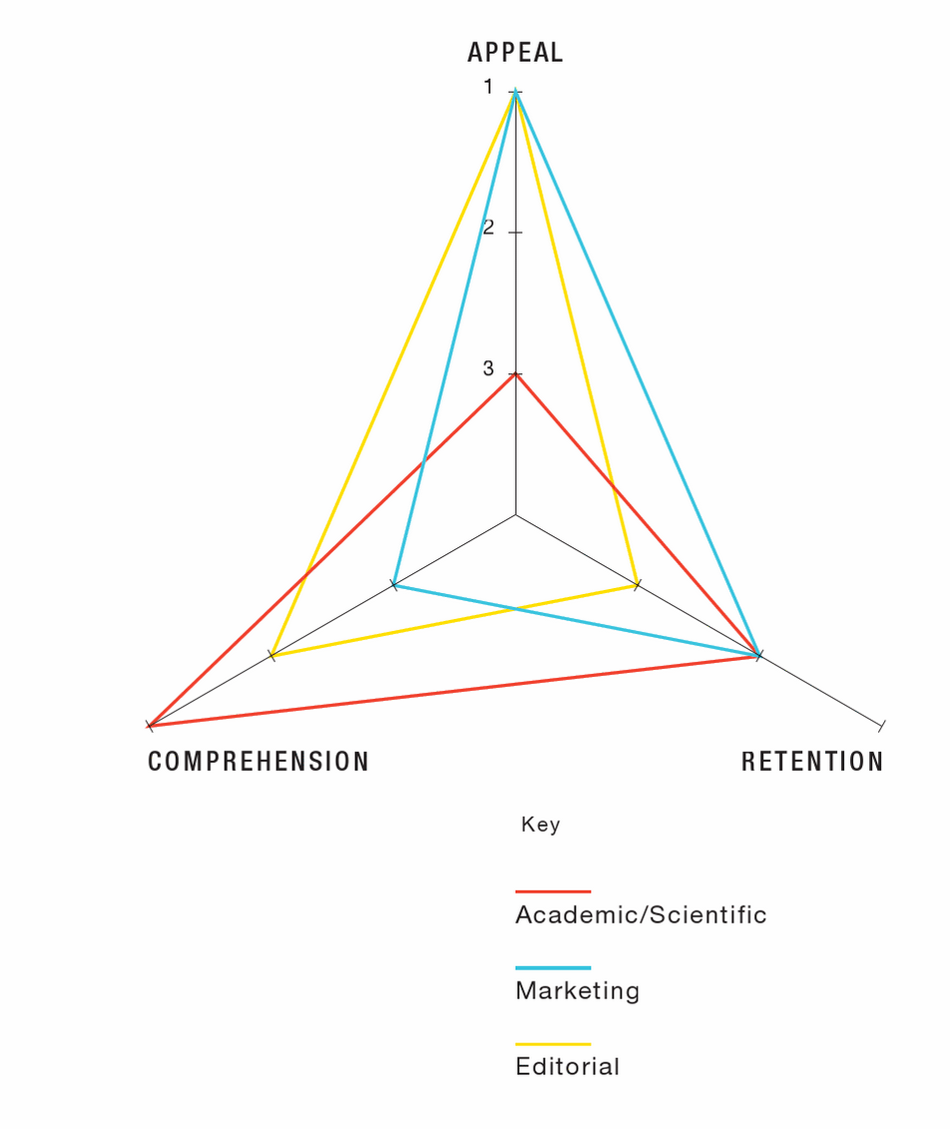
Before You Start
Who is the audience?
What is the purpose or goal?
What is the story?
What are the standards or conventions?
Infographics : The Power of Visual Storytelling by Lankow, Jason, Crooks, Ross, Ritchie, Josh
Notes:
Hannah - before and throughout the process, it is important to consider the audience, purpose/story, and any domain standards or conventions.

Slide 7
Workshop Agenda
Introduction to Data Visualization
Why We Visualize
Understanding Data
Visualizations
Tools and Software
Visualization Design and Best Practices

Slide 8
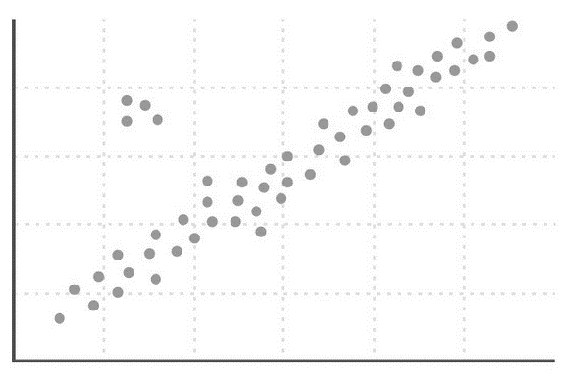
Why Do Visualization
Reasons for doing data visualization
Exploration
Use visualizations as a means of data exploration
Analysis
Verify (or Falsify) a hypothesis
Presentation
Visualization is used to communicate results or findings

Slide 9
Why Do Visualization
Reasons for doing data visualization
Exploration
Use visualizations as a means of data exploration
Analysis
Verify (or Falsify) a hypothesis
Presentation
Visualization is used to communicate results or findings

Slide 10

Why Do Visualization
Reasons for doing data visualization
Exploration
Use visualizations as a means of data exploration
Analysis
Verify (or Falsify) a hypothesis
Presentation
Visualization is used to communicate results or findings

Slide 11
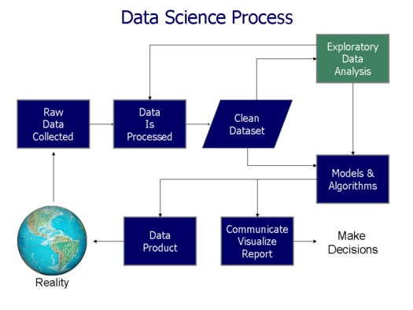
Data Science Process
Acquire Data
“Know your data”
Clean and Pre-Process
Visualize (explore)
Model/Analyze
Communicate Findings/ Data Production
https://commons.wikimedia.org/wiki/File:Data_visualization_process_v1.png
Notes:
Jennifer

Slide 12
Workshop Agenda
Introduction to Data Visualization
Why We Visualize
Understanding Data
Visualizations
Tools and Software
Visualization Design and Best Practices

Slide 13
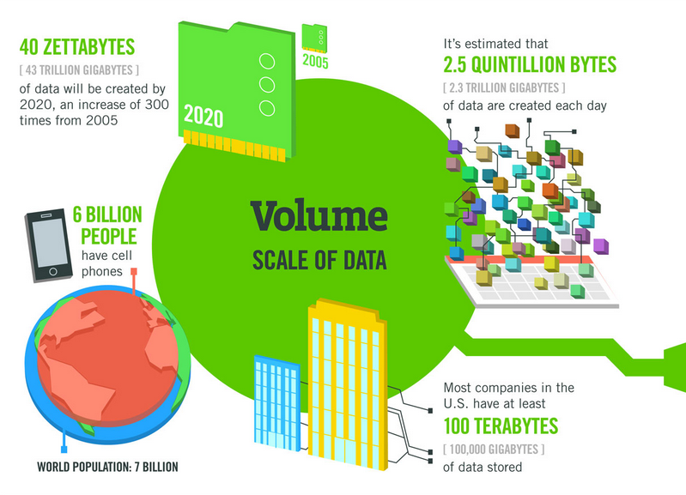

Data Doesn’t Sleep
A Minute on the Internet
16M texts
156M emails
900K FB logins
1.8M Snaps
450K Tweets
3.5M Google Searches
1M tinder Swipes
70K Hours of Netflix
$751,000 Spent Online
http://www.visualcapitalist.com/happens-internet-minute-2017/

Slide 14
Data Types
Not all data are created equal!
Qualitative
Nominal
Ordinal
Quantitative
Numerical
Discrete
Continuous

Slide 15
Nominal Data
Data that can be counted, but not aggregated or ordered
Examples:
States – Ohio, Kentucky, Indiana
Eye Color –Blue, Brown, Green, Hazel
Music Genre – Rock, Classical, Rap, Pop

Slide 16
Ordinal Data
Data that can be counted and ordered, but not aggregated.
Examples:
Quality – Poor, Average, Good, Excellent
Sizes – Small, Medium, Large
Letter Grades – A, B, C, D, F
Ranked Numbers – Position in a race (1st, 2nd, 3rd)

Slide 17
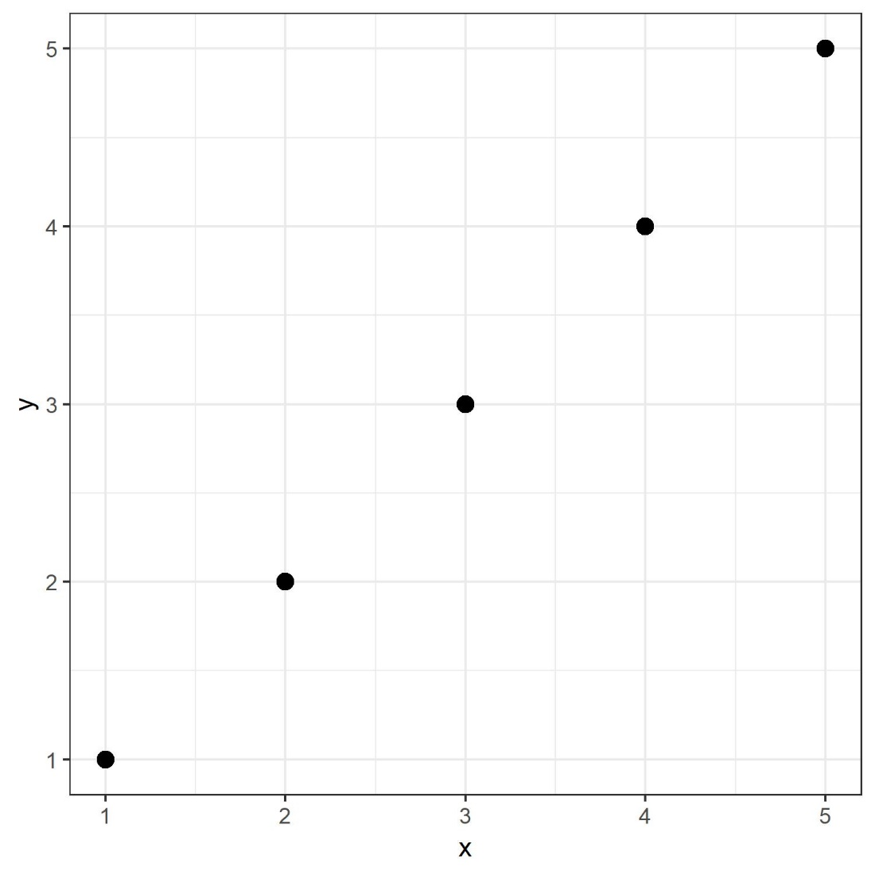
Numerical Data
Numerical data can be counted, ordered, and aggregated.
Two types of quantitative data
Discrete
Number of People
Sampling –Hourly average temperature
Continuous
Elevation
Temperature

Slide 18
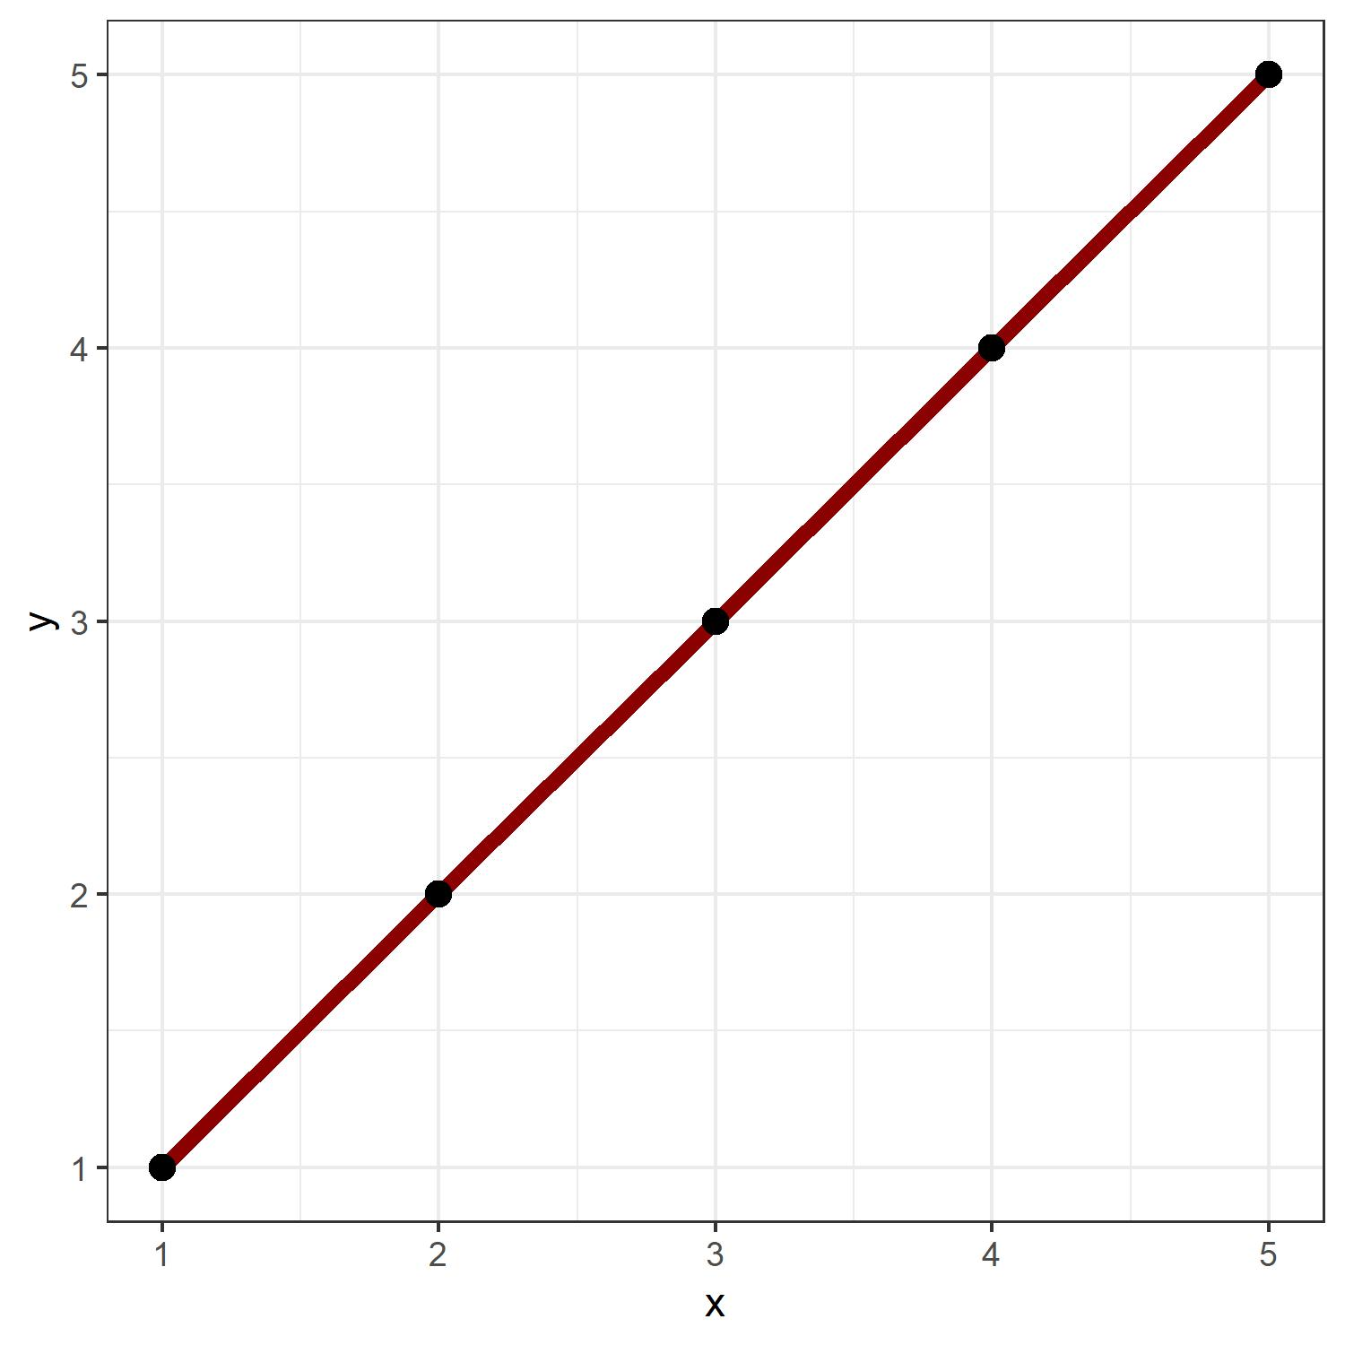
Numerical Data
Numerical data can be counted, ordered, and aggregated.
Two types of quantitative data
Discrete
Number of People
Sampling –Hourly average temperature
Continuous
Elevation
Temperature

Slide 19
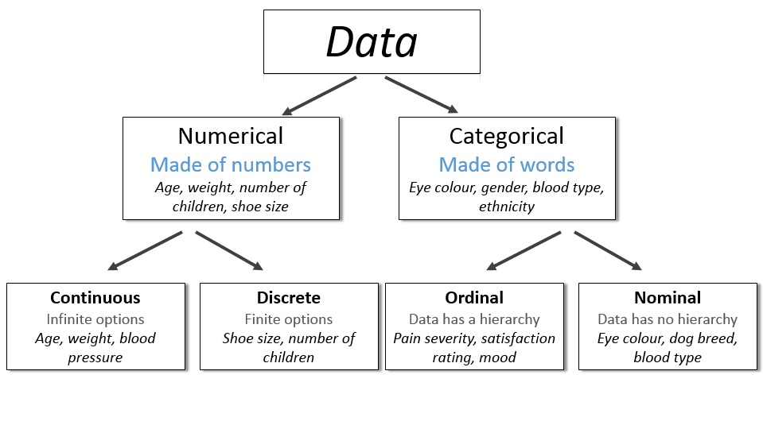
http://survivestatistics.com/variables/

Slide 20
Primitive Data Types
Boolean:
True (T) or False (F)
Char:
Characters and Strings – “A”, “Beta”, “There are different data types!”
Int:
Integers – (1, 2, 100)
Float/Double:
Decimal – (0.1, 0.2, 0.1352)

Slide 21
Workshop Agenda
Introduction to Data Visualization
Why We Visualize
Understanding Data
Visualizations
Tools and Software
Visualization Design and Best Practices

Slide 22
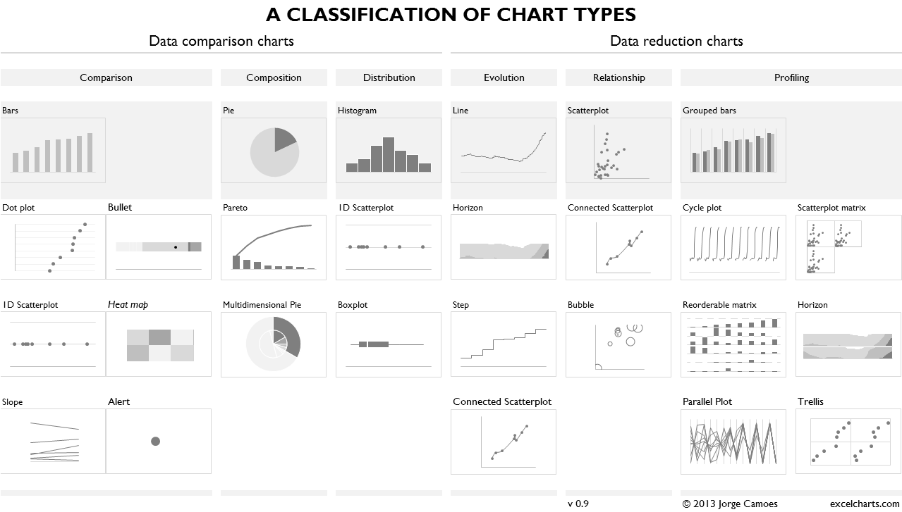
Four Basic Chart Types
Comparison
Composition
Distribution
Relationship
https://excelcharts.com/classification-chart-types/

Slide 23
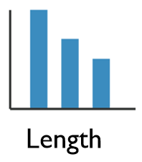
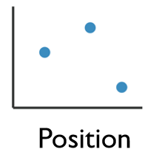
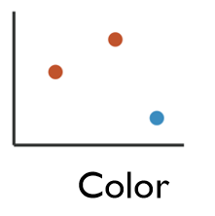
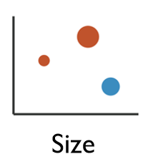
Enhancing Visualizations
1 Dimensional Data
Length
2 Dimensional Data
Position
2+ Dimensional Data
Position
Color Hue/Saturation
Size
Shape

Slide 24
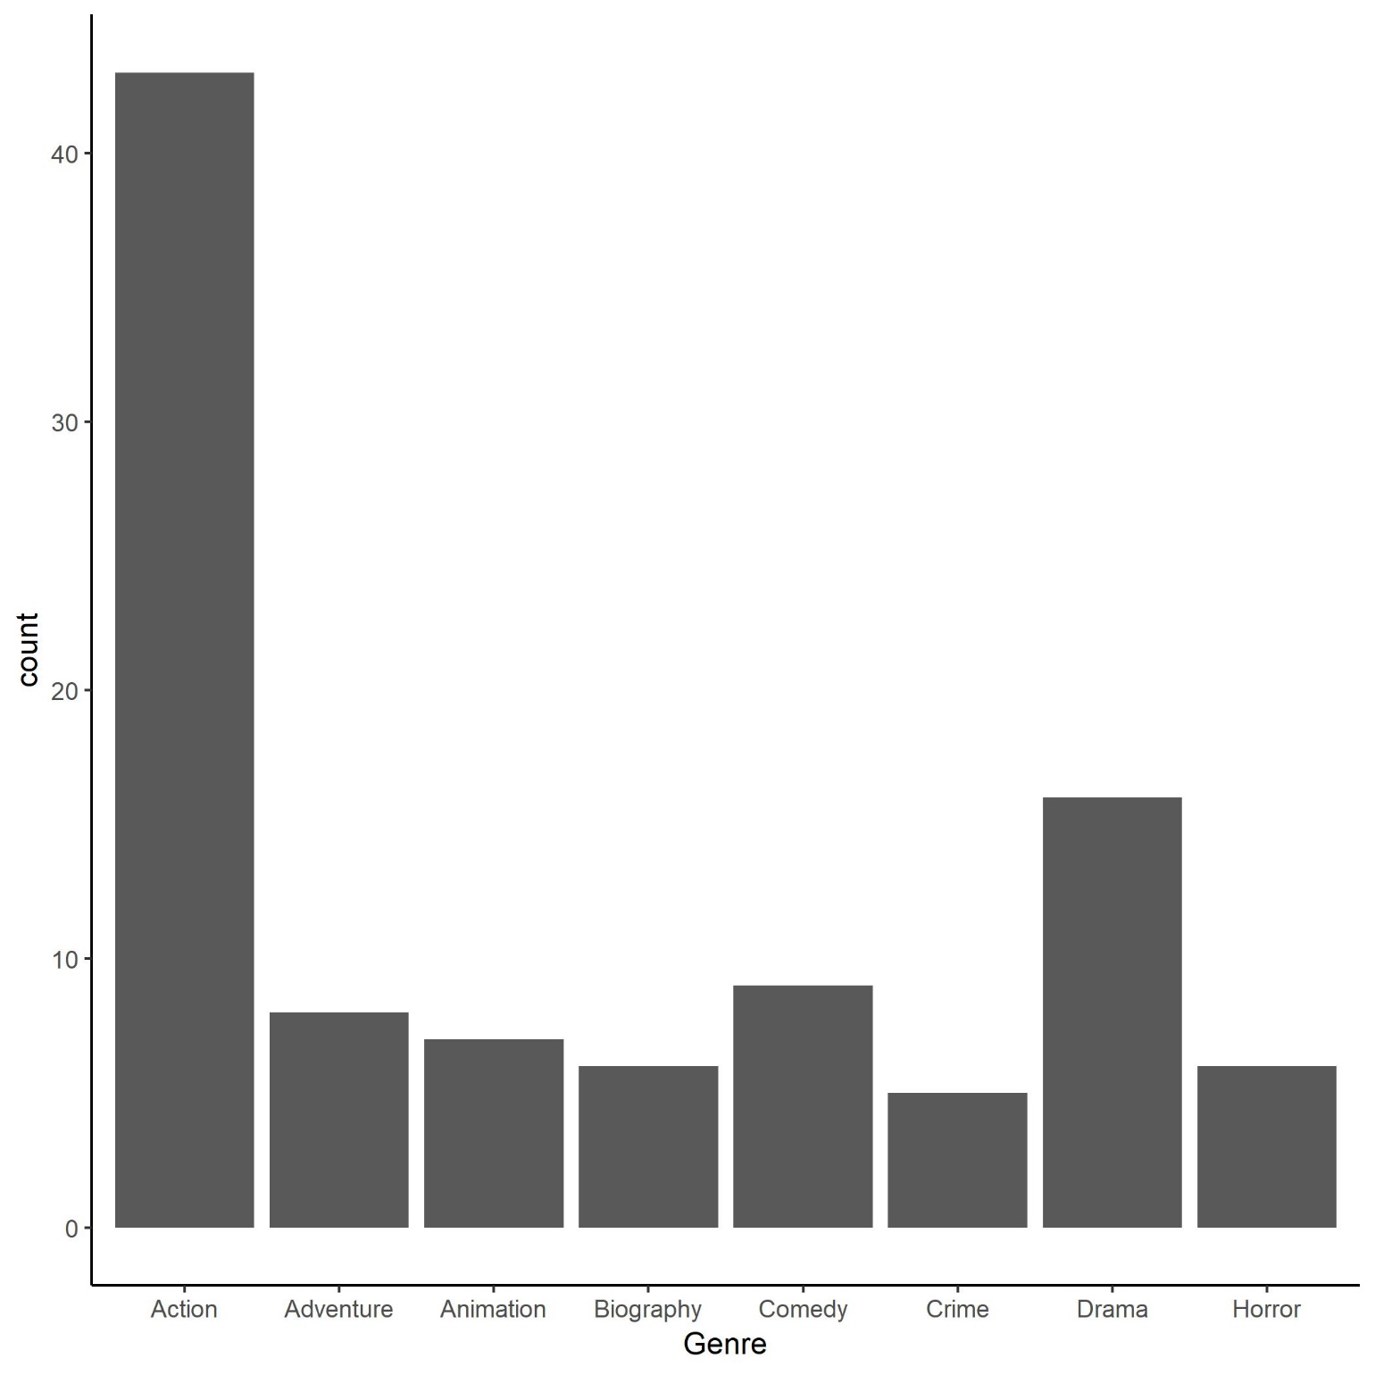
Column Charts
Comparison or Distribution of Groups
Column
Bar
Histogram

Slide 25
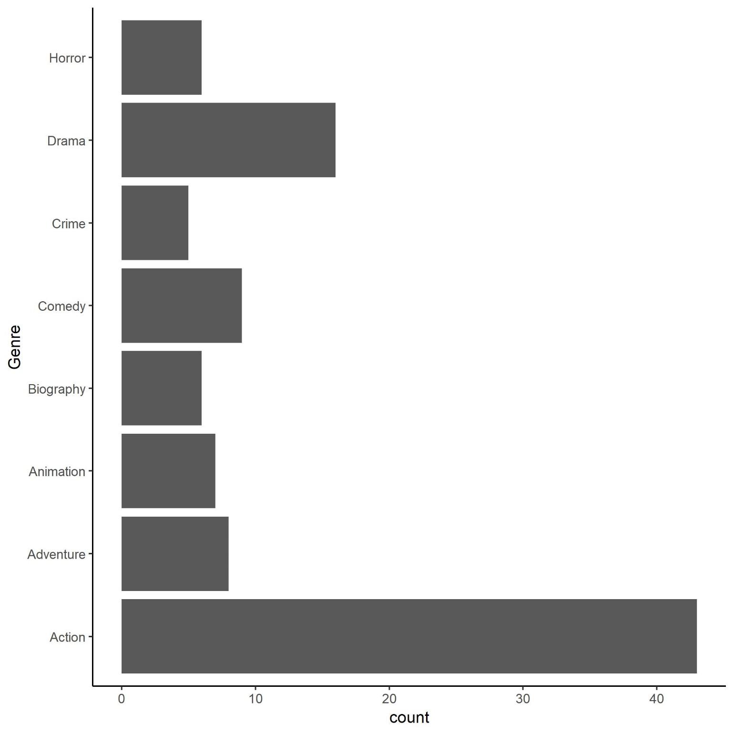
Column Charts
Comparison or Distribution of Groups
Column
Bar
Histogram

Slide 26
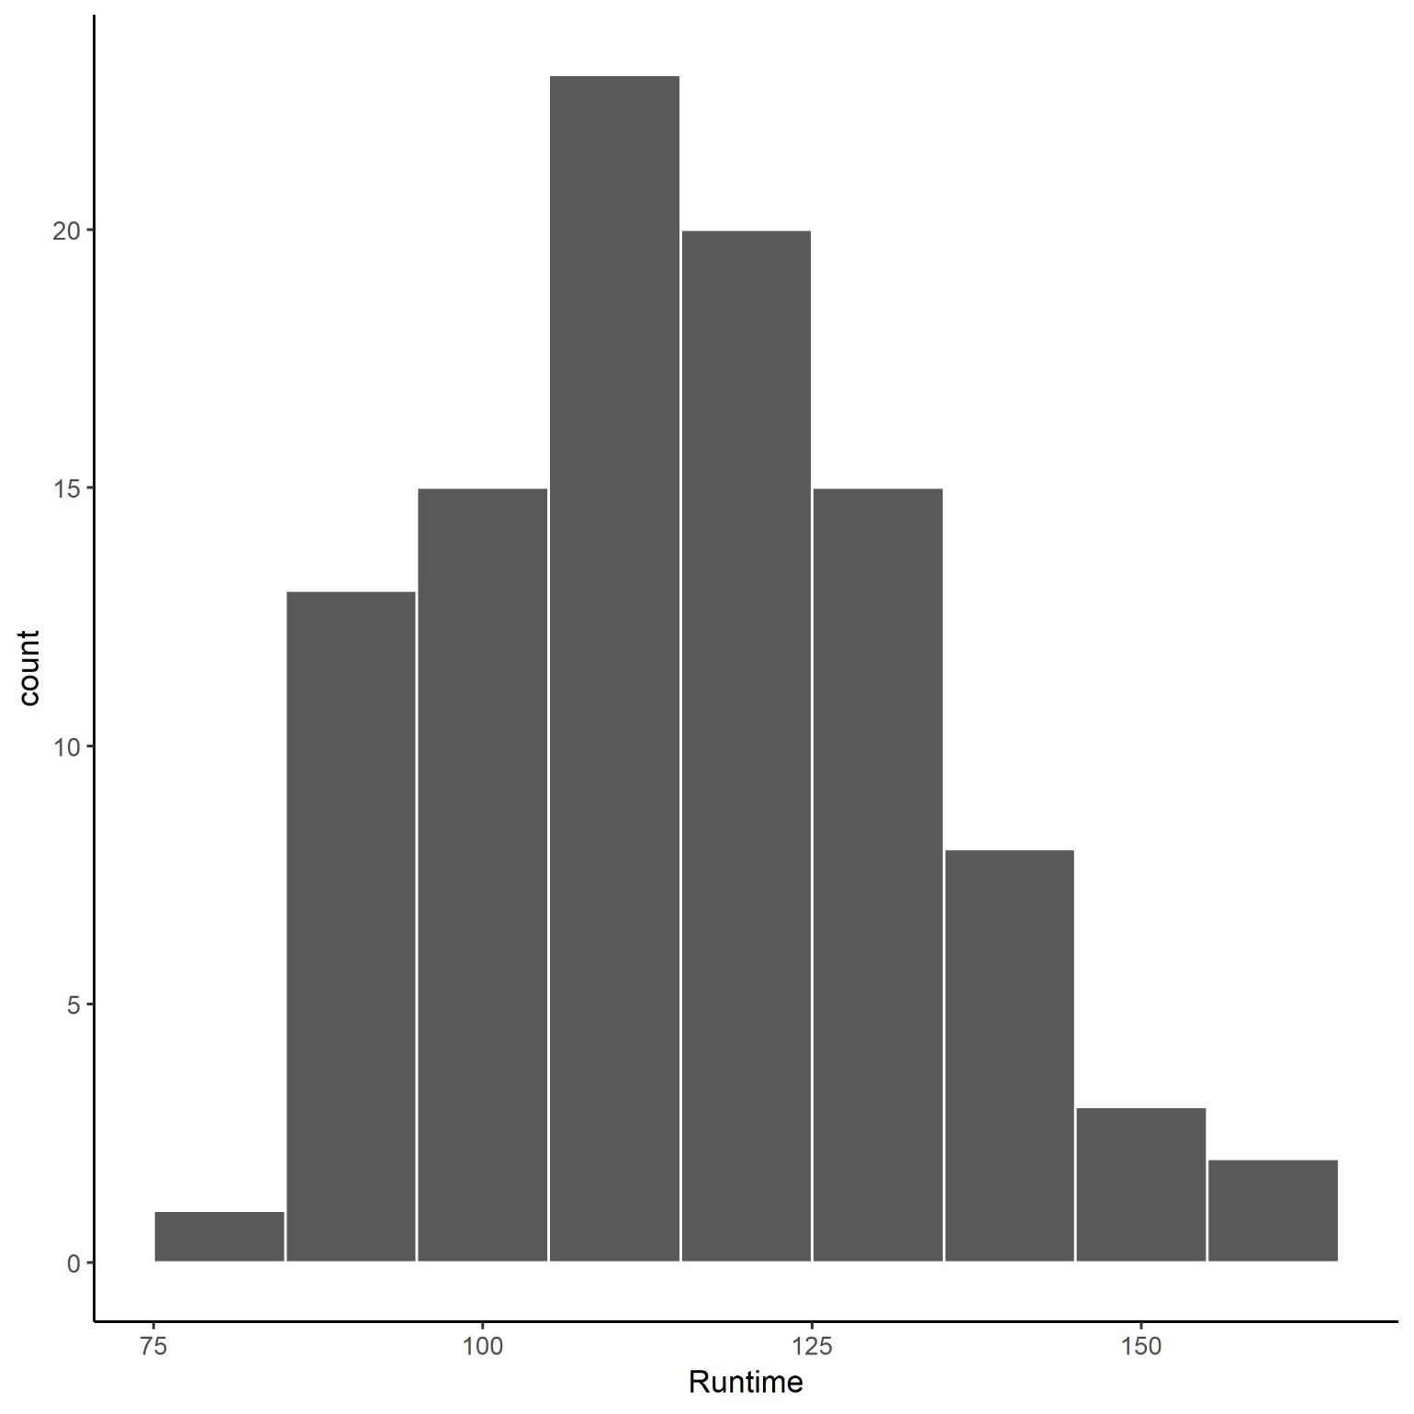
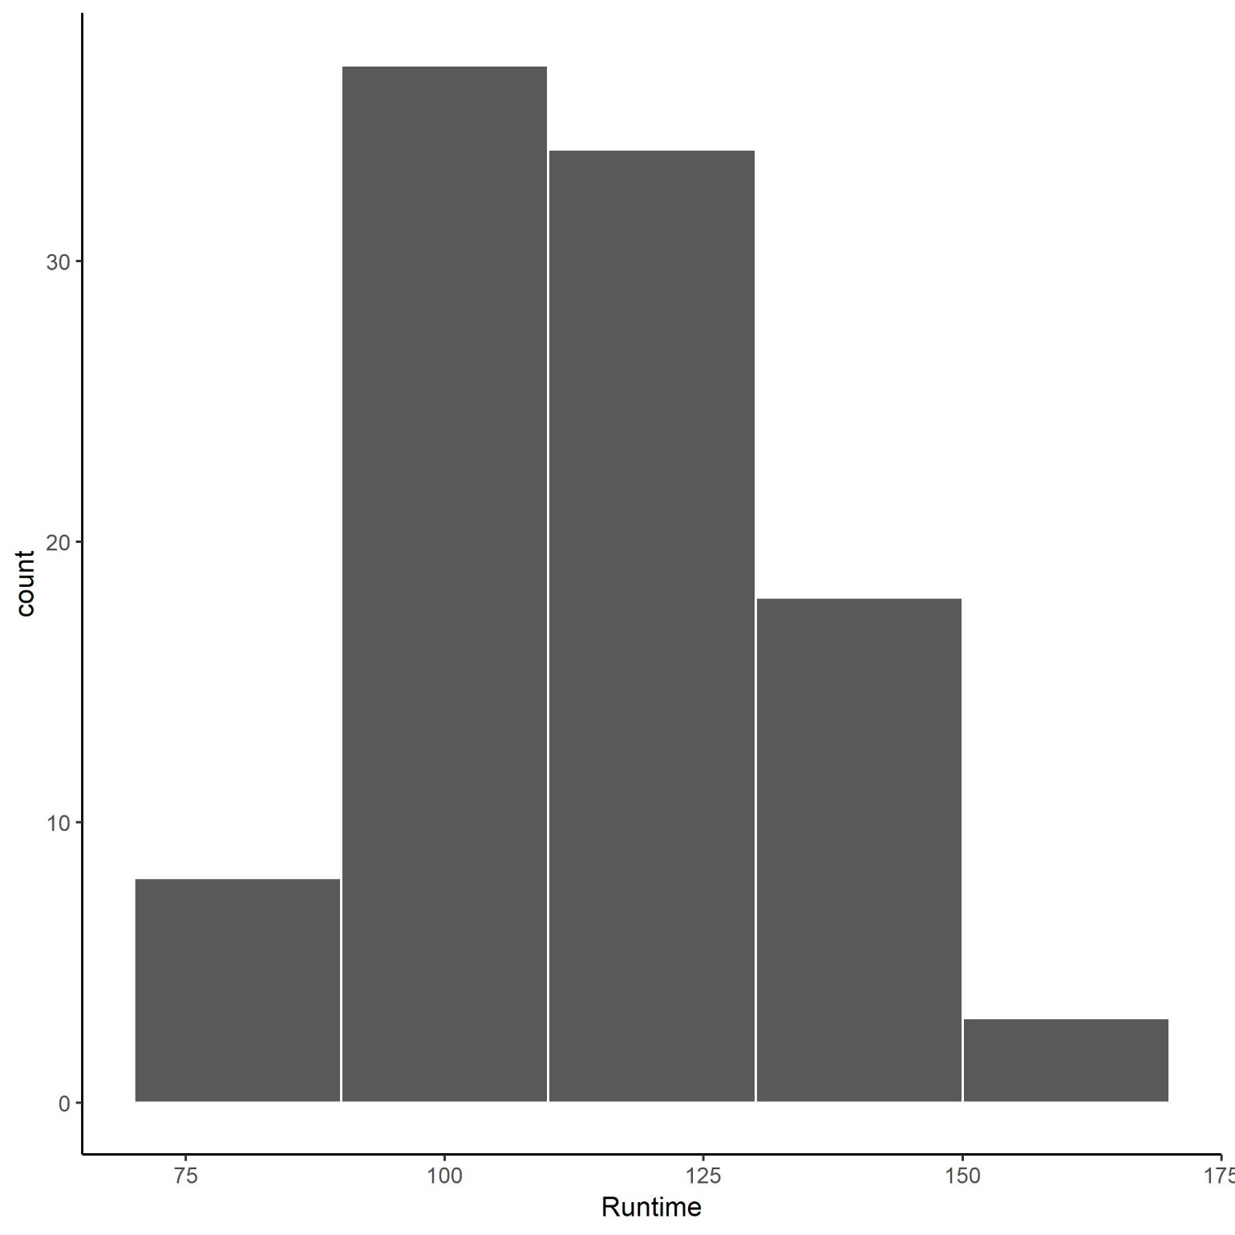
Column Charts
Comparison or Distribution of Groups
Column
Bar
Histogram

Slide 27
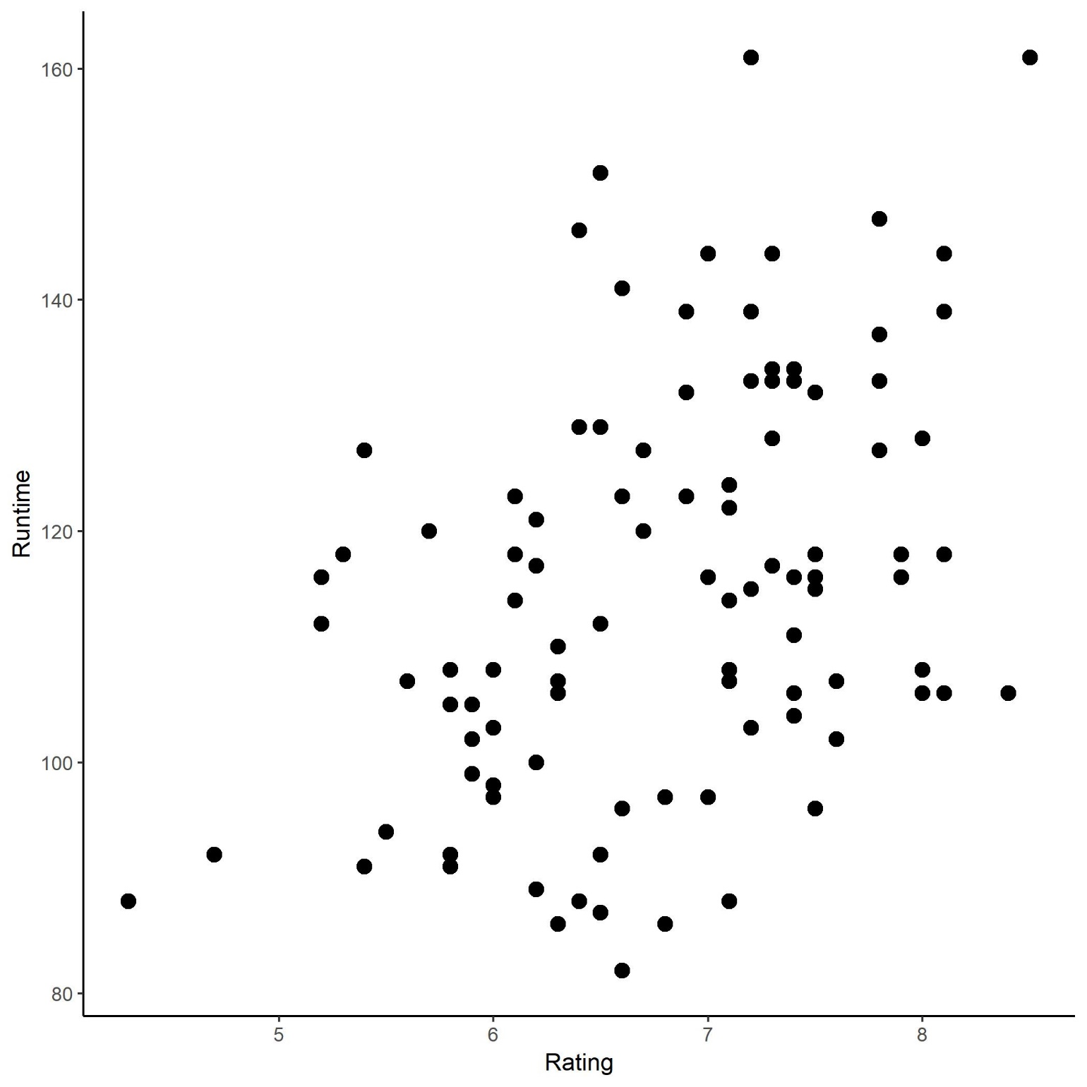
Scatter and Bubble Plots
Distribution and Relationships between two or more variables
Scatter Plot
Bubble Chart

Slide 28
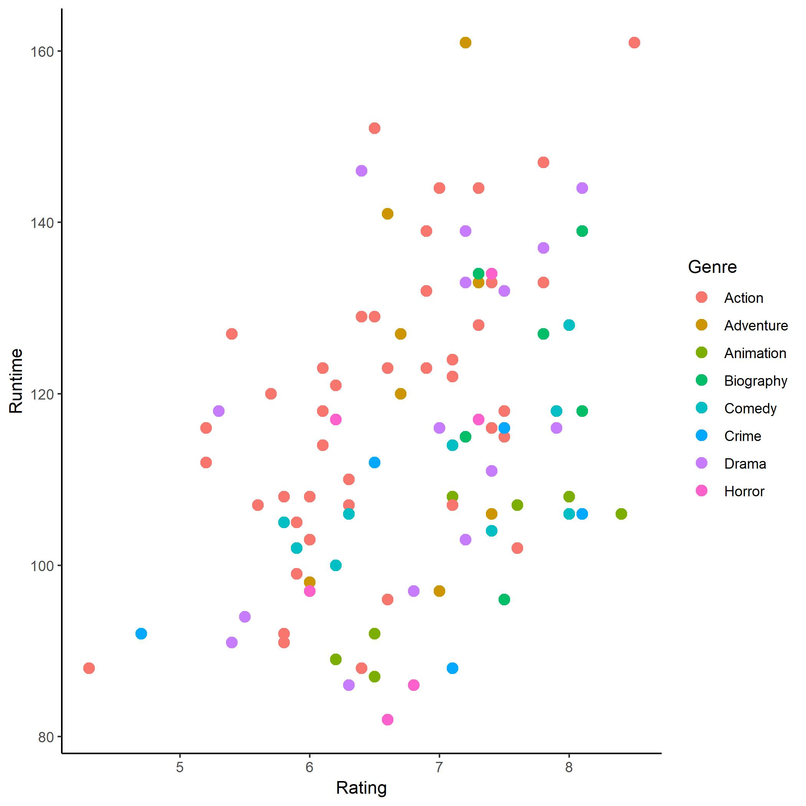
Scatter and Bubble Plots
Distribution and Relationships between two or more variables
Scatter Plot
Bubble Chart

Slide 29
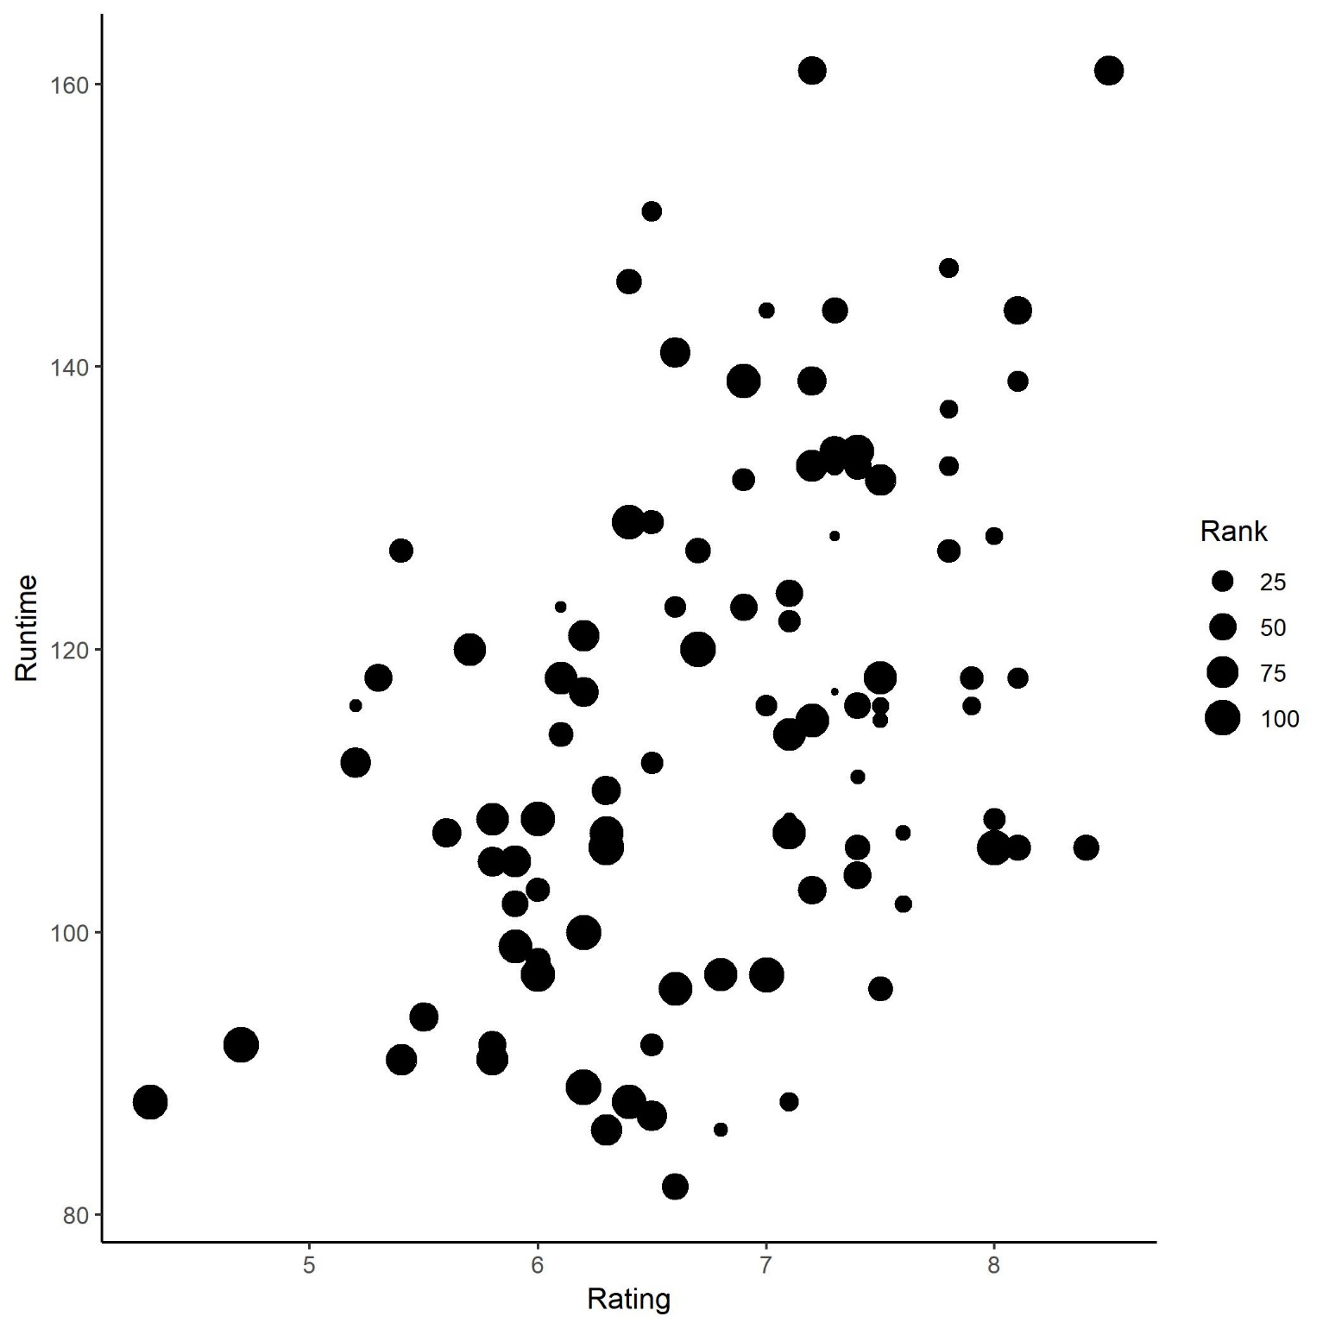
Scatter and Bubble Plots
Distribution and Relationships between two or more variables
Scatter Plot
Bubble Chart

Slide 30
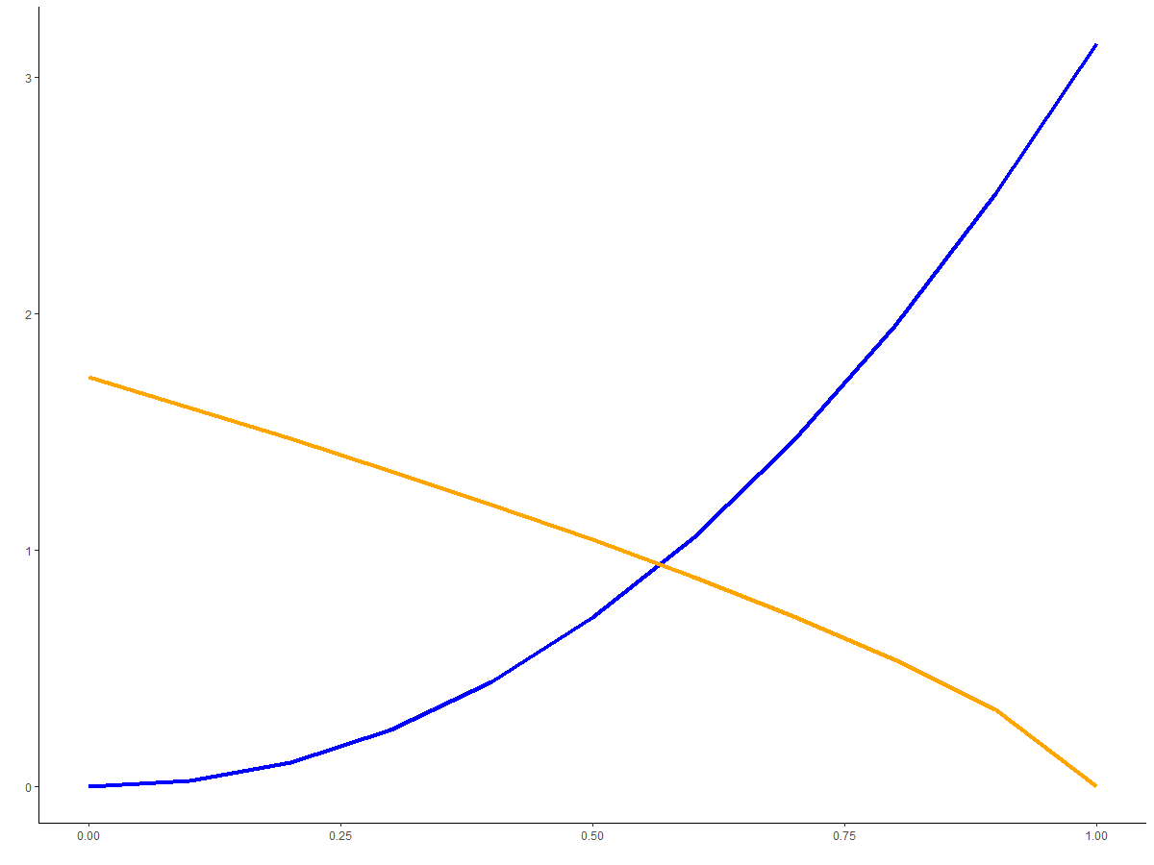
Line and Area Graphs
Distribution and Relationships over continuous data
Line
Area

Slide 31
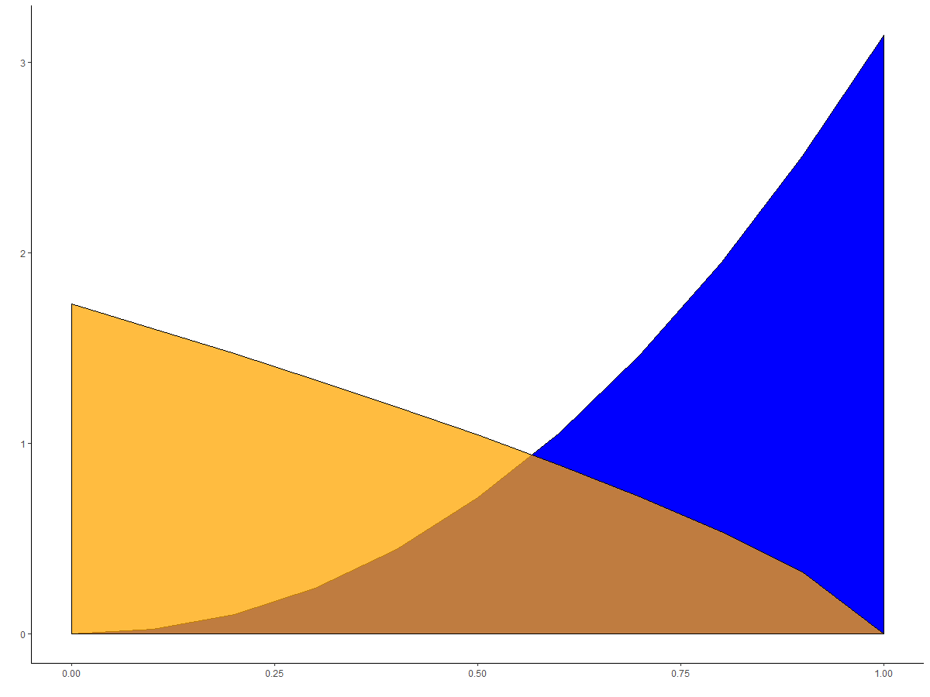
Line and Area Graphs
Distribution and Relationships over continuous data
Line
Area

Slide 32
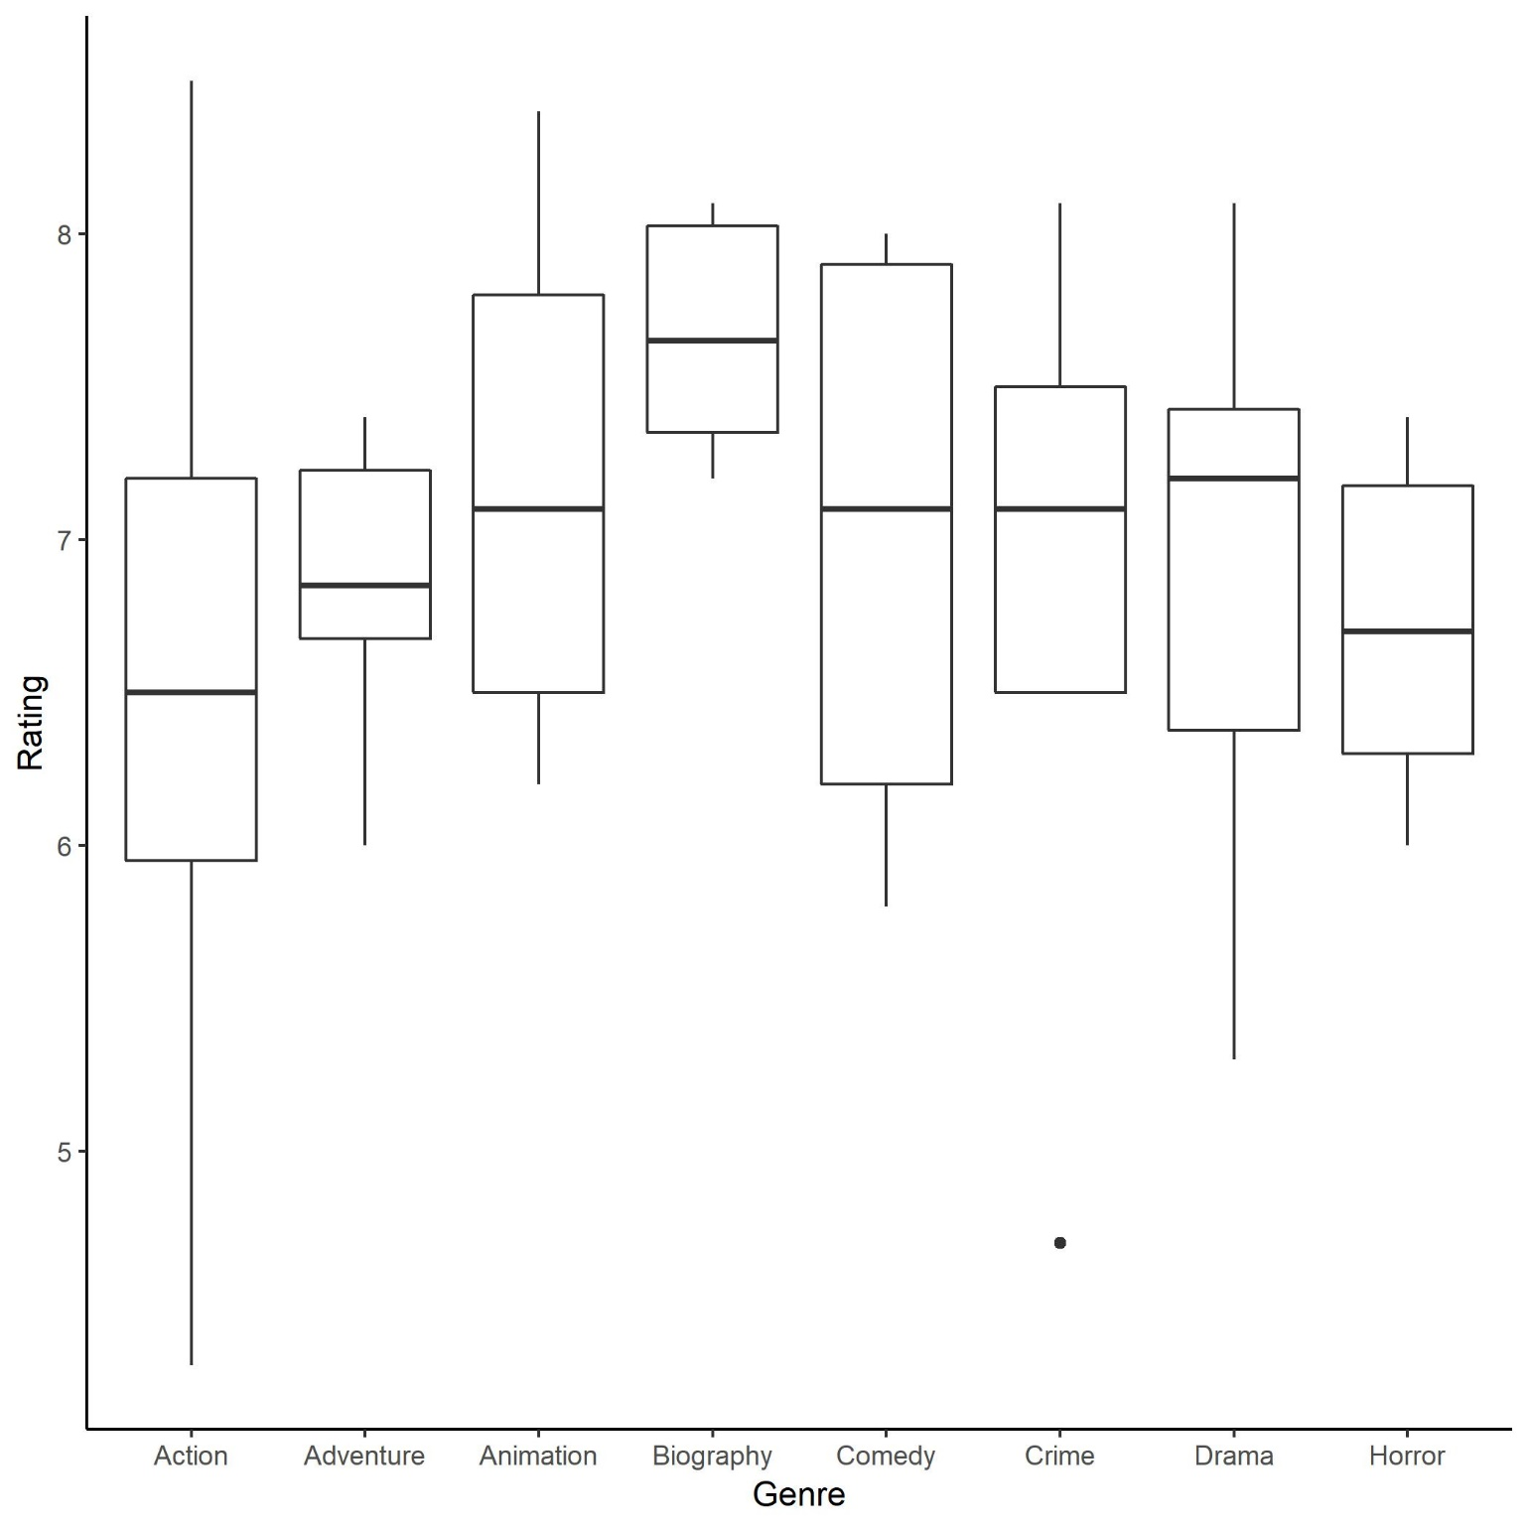
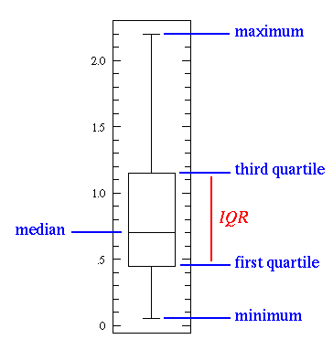
Statistical Graphs
Provide distribution and descriptive statistical information
Boxplots
Violin Graphs

Slide 33
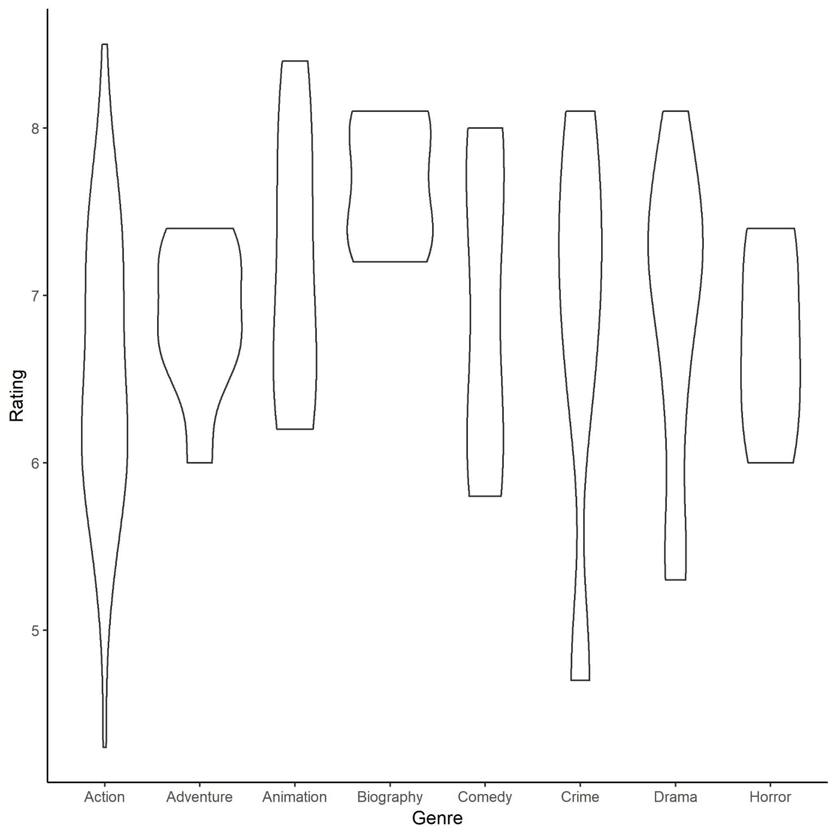
Statistical Graphs
Provide distribution and descriptive statistical information
Boxplots
Violin Graphs

Slide 34
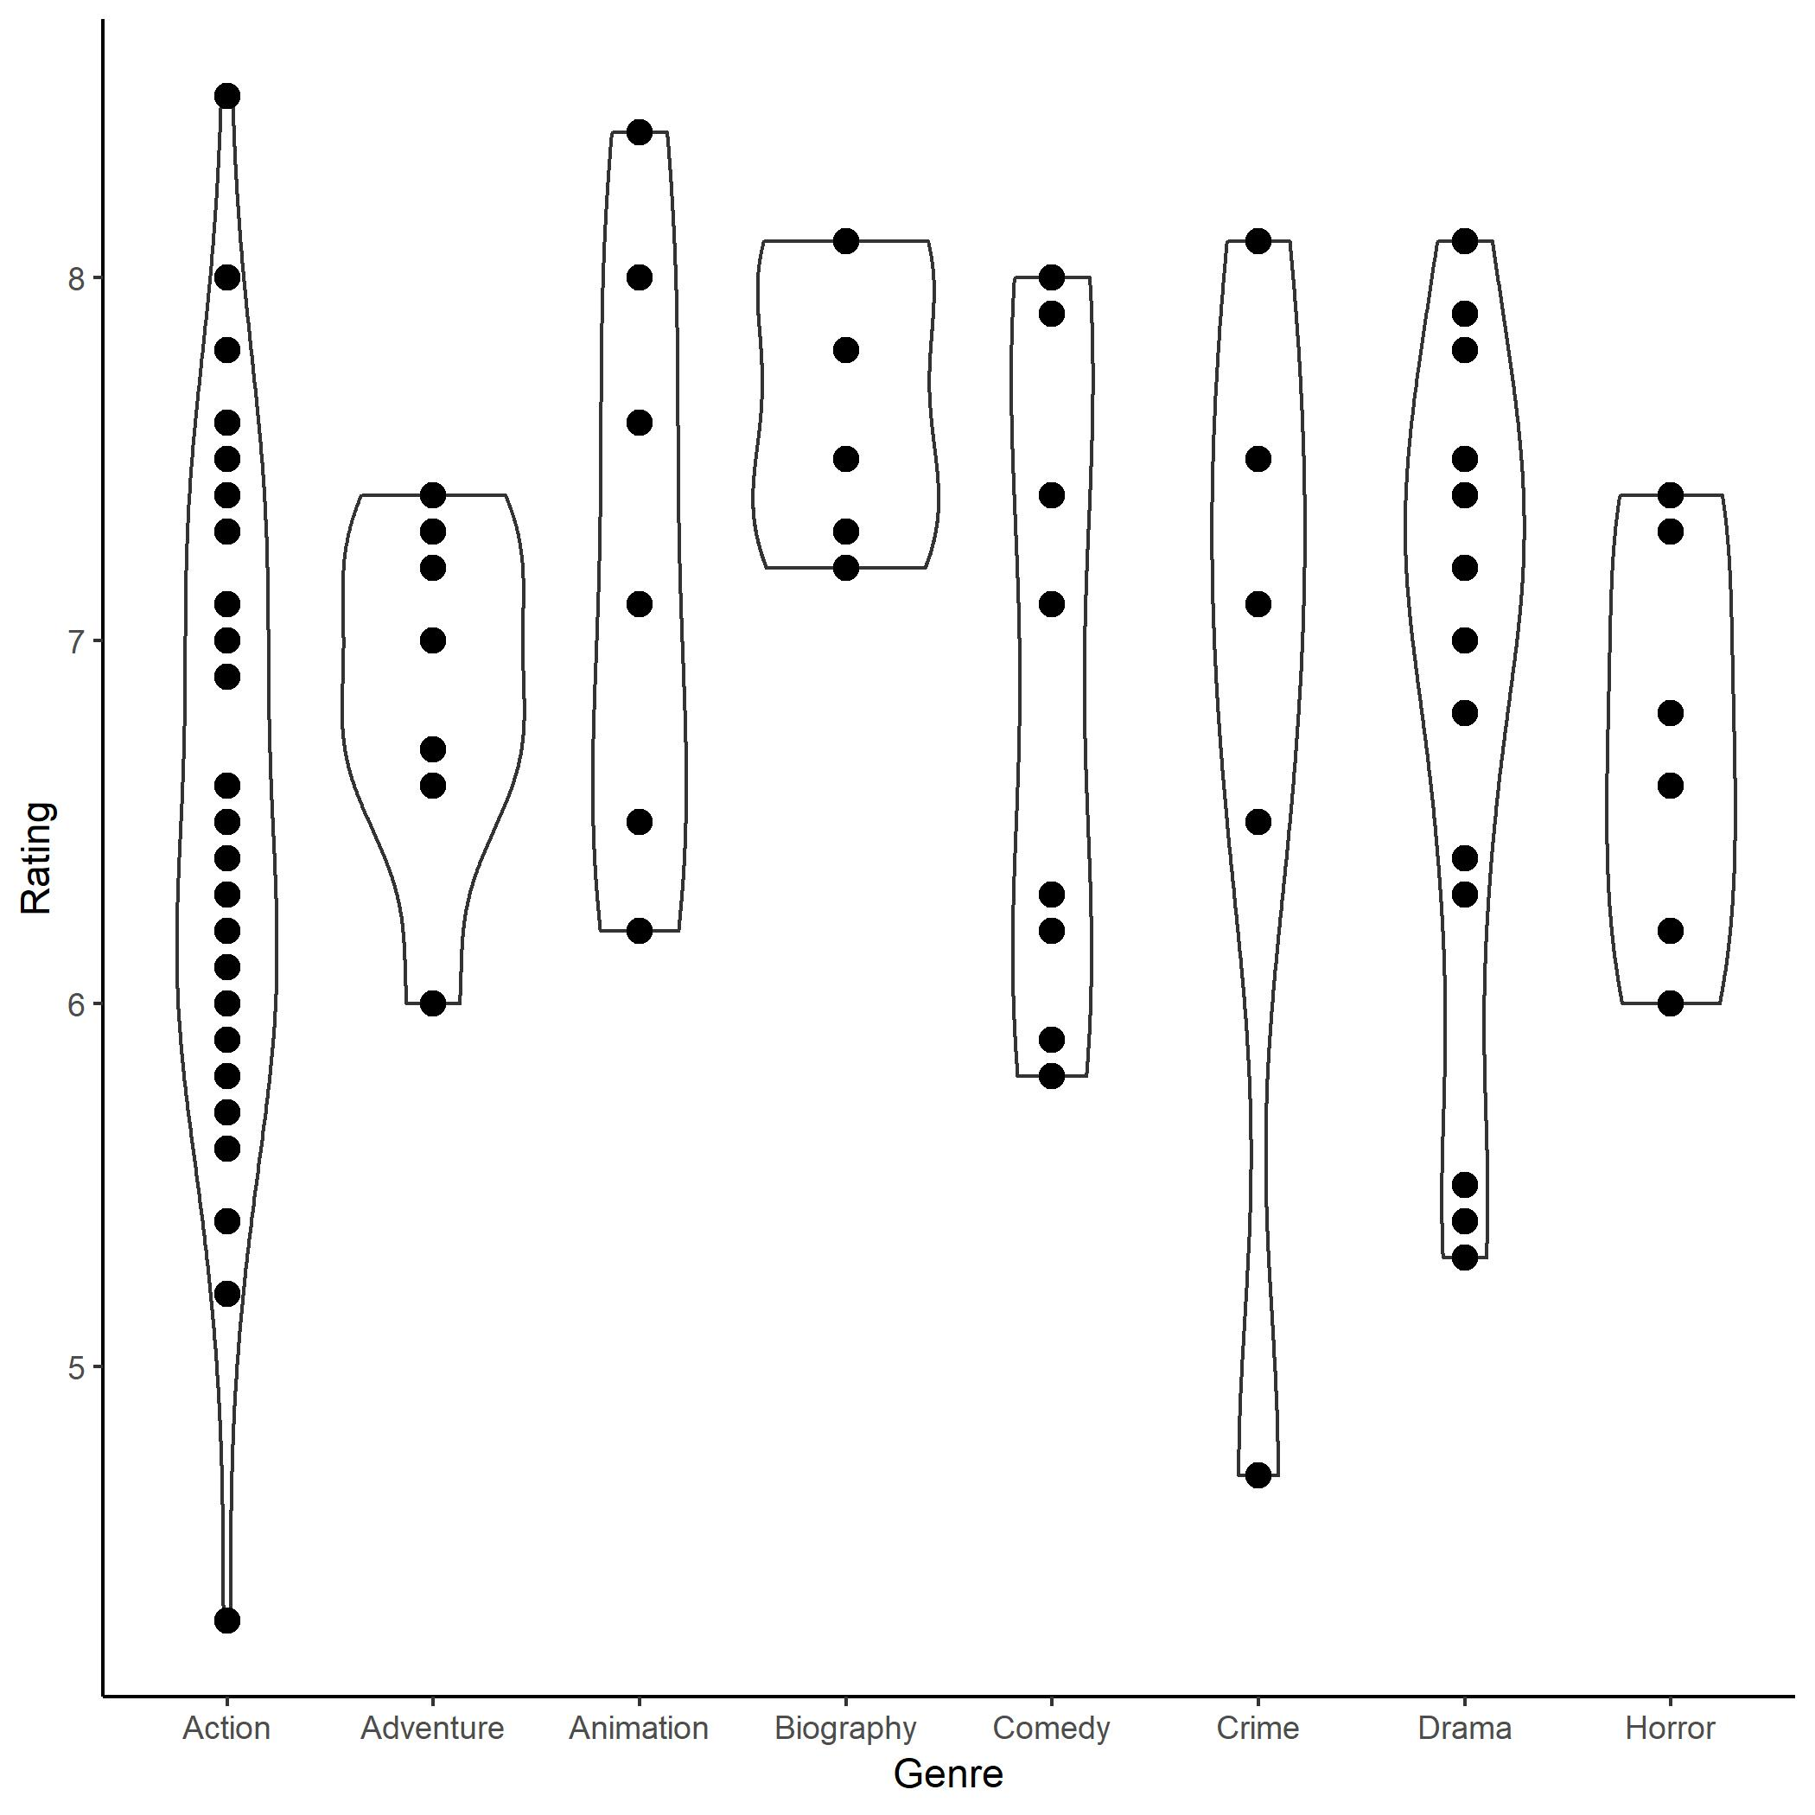
Statistical Graphs
Provide distribution and descriptive statistical information
Boxplots
Violin Graphs

Slide 35
Other Graphs
Stacked Plots
Polar Coordinate Graph
Facet Graph
Combined Charts
Heat Map
Geographic Map

Slide 36
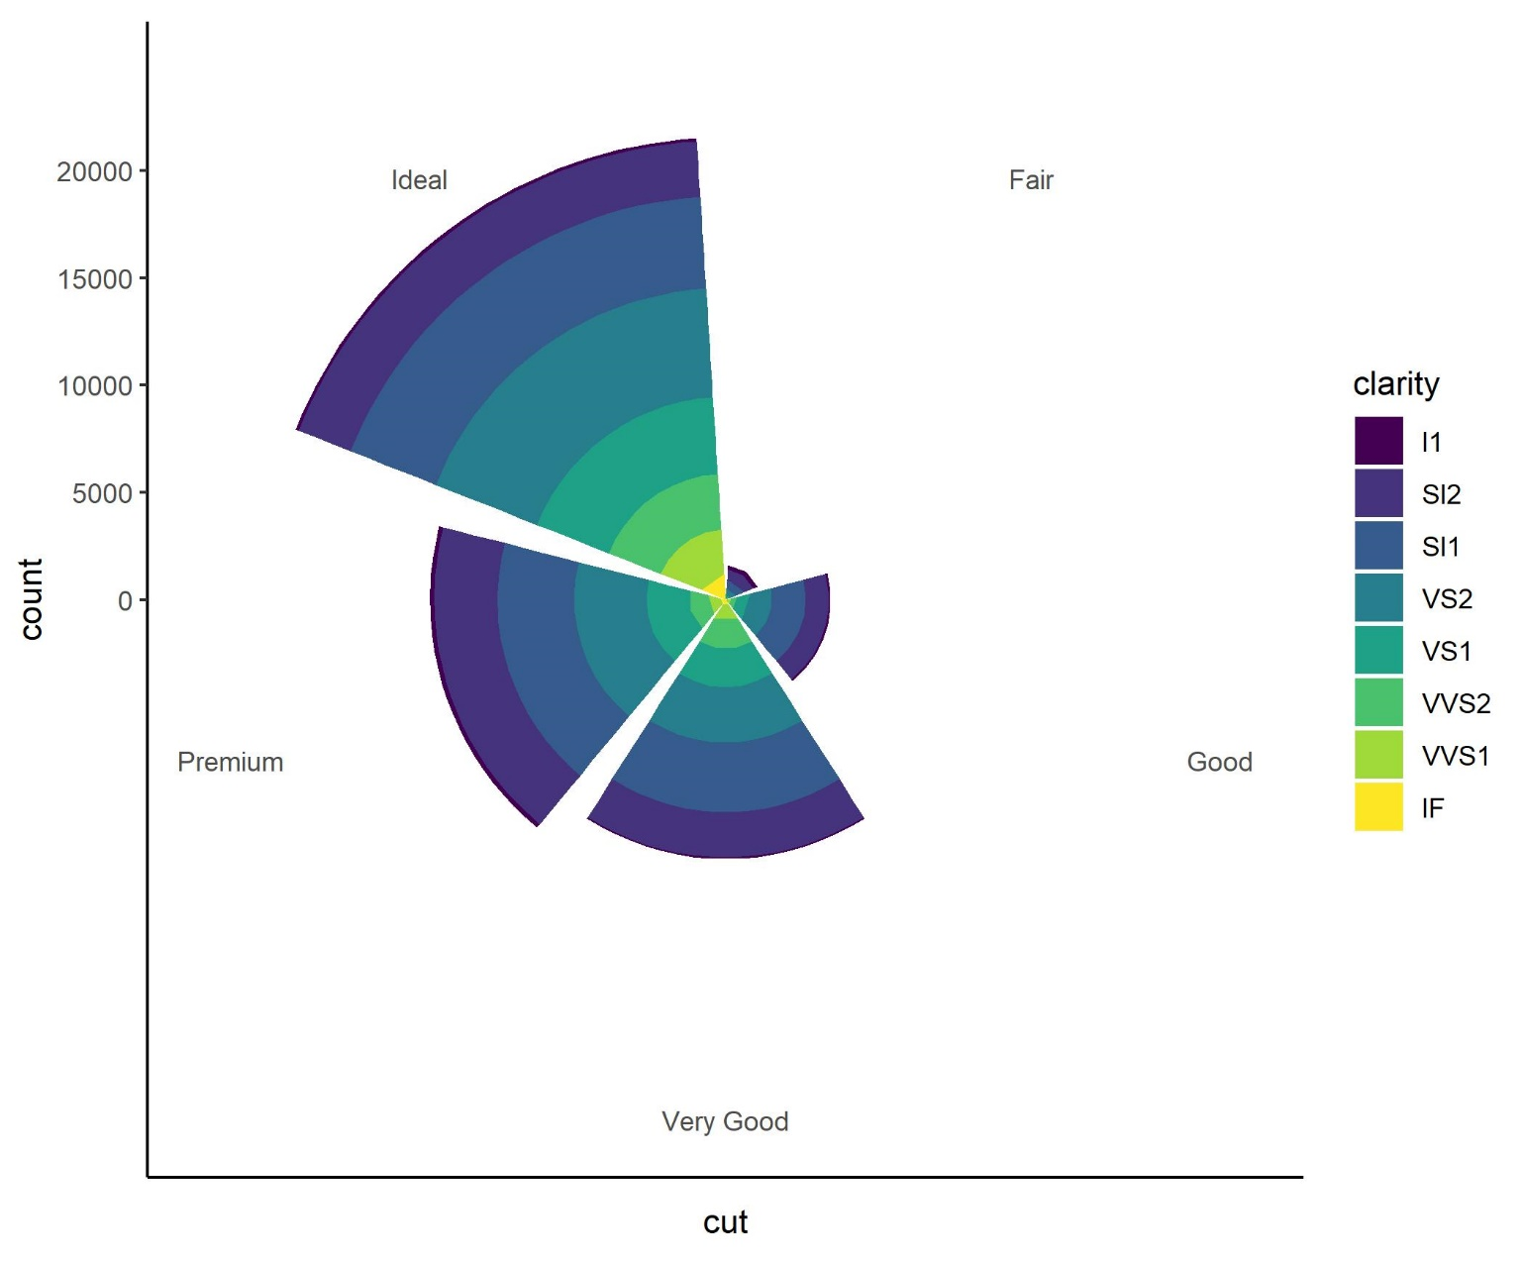
Other Graphs
Stacked Plots
Polar Coordinate Graph
Facet Graph
Combined Charts
Heat Map
Geographic Map

Slide 37
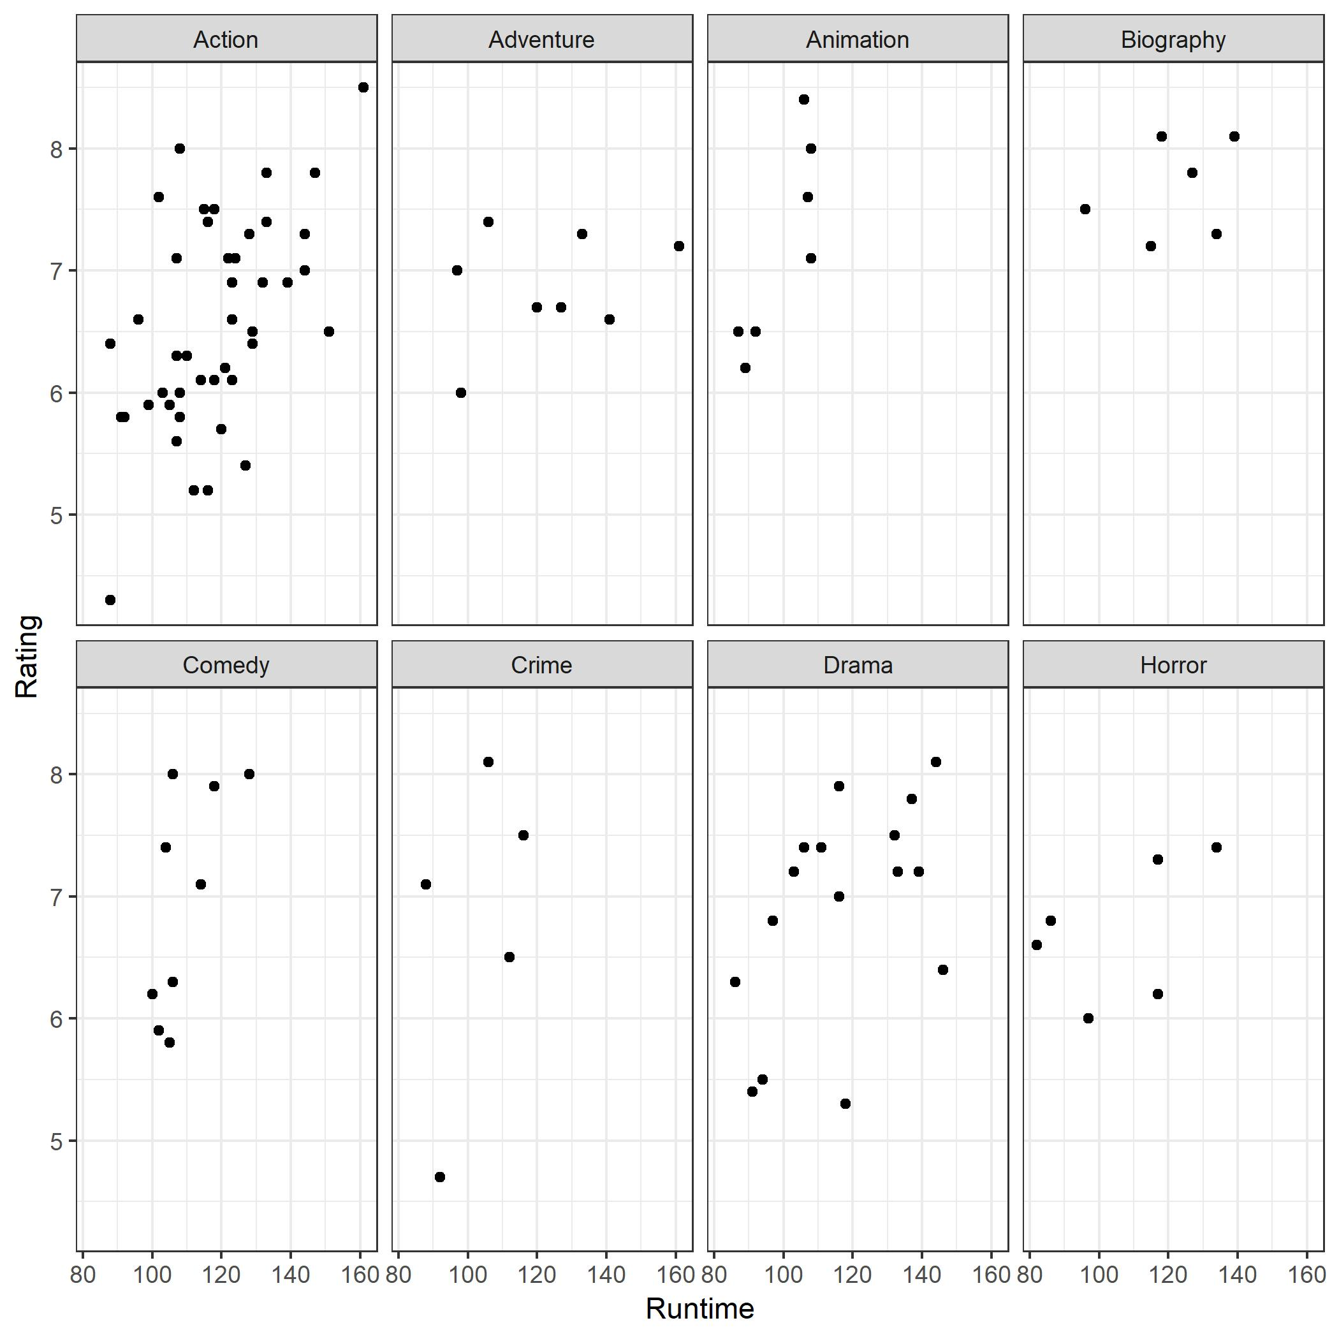
Other Graphs
Stacked Plots
Polar Coordinate Graph
Facet Graph
Combined Charts
Heat Map
Geographic Map

Slide 38
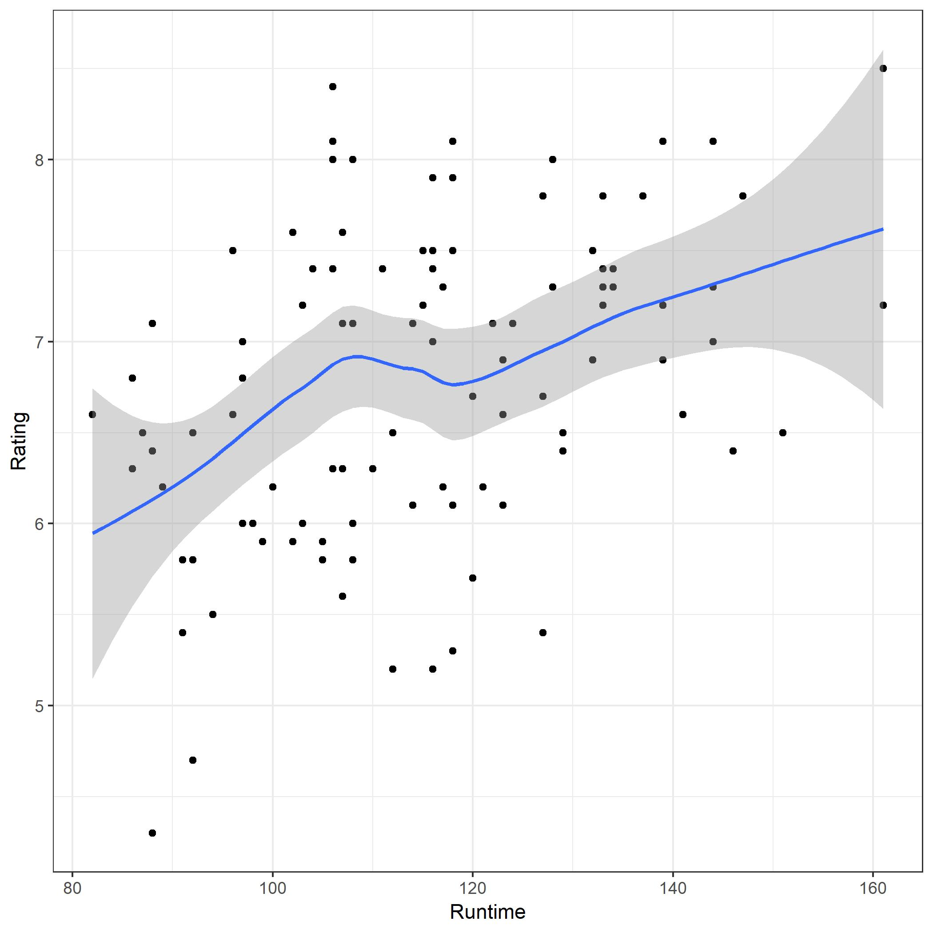
Other Graphs
What does the blue line tell you?
Stacked Plots
Polar Coordinate Graph
Facet Graph
Combined Charts
Heat Map
Geographic Map

Slide 39
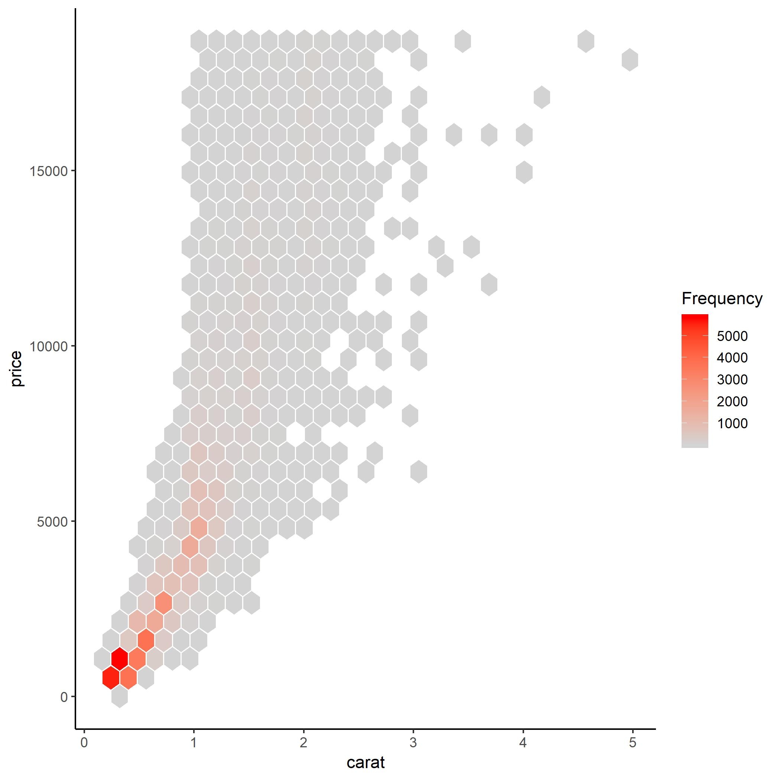
Other Graphs
Polar Coordinate Graph
Facet Graph
Combined Charts
Heat Map
Geographic Map

Slide 40
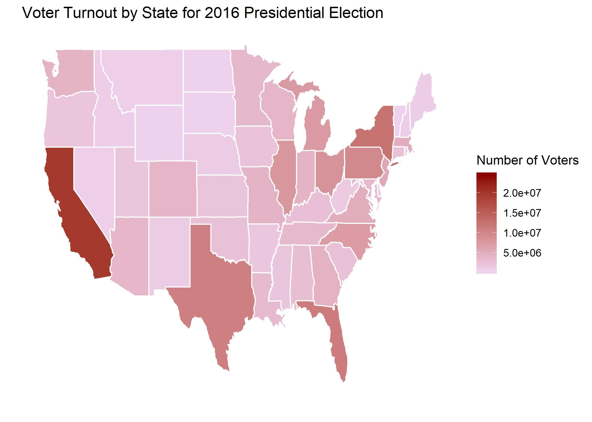
Other Graphs
Polar Coordinate Graph
Facet Graph
Combined Charts
Heat Map
Geographic Map

Slide 41
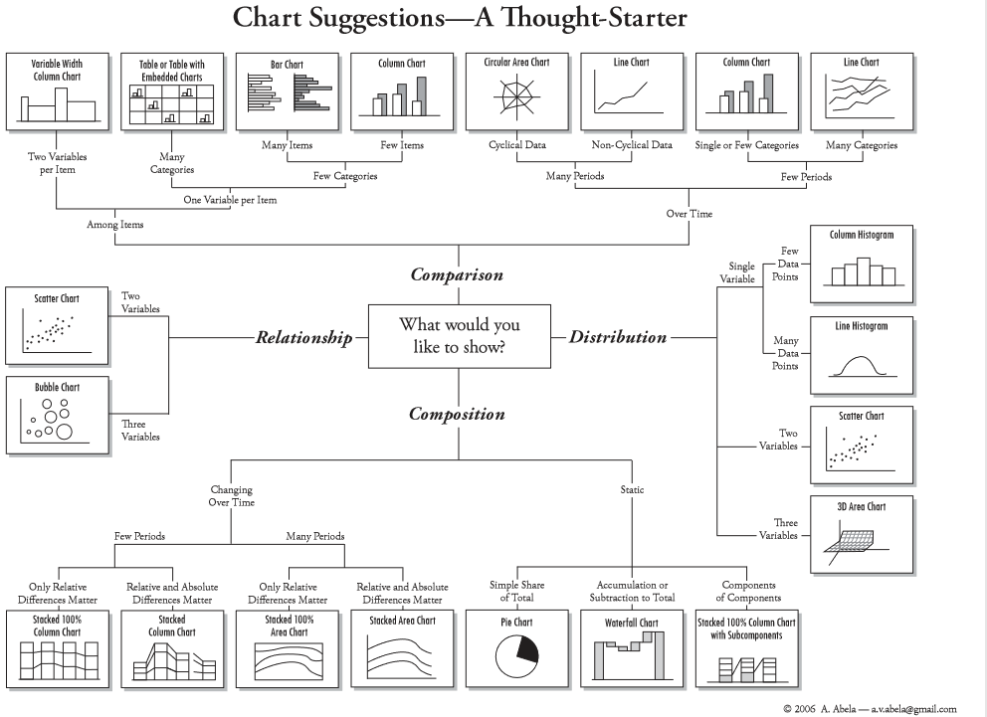

Slide 42
Workshop Agenda
Introduction to Data Visualization
Why We Visualize
Understanding Data
Visualizations
Tools and Software
Visualization Design and Best Practices

Slide 43















Data Visualization Software
Free:
Orange
QGIS
R
Python
Tableau (public)
Java-Script
D3
Leaflet
Chartist
Plotly
Cost:
Excel
Power BI (Microsoft
Tableau (Desktop)
SPSS
SAS
MATLAB
ArcGIS
Looker

Slide 44
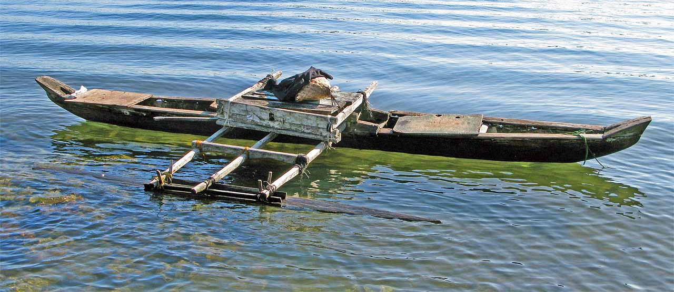

The Right Tool for the Job
Things to consider:
What are your deliverables?
Bar chart, analytical model, dashboard?
Data size
Cost
Time
Reproducibility
Industry Standards
Etc.

Slide 45
Workshop Agenda
Introduction to Data Visualization
Why We Visualize
Understanding Data
Visualizations
Tools and Software
Visualization Design and Best Practices

Slide 46
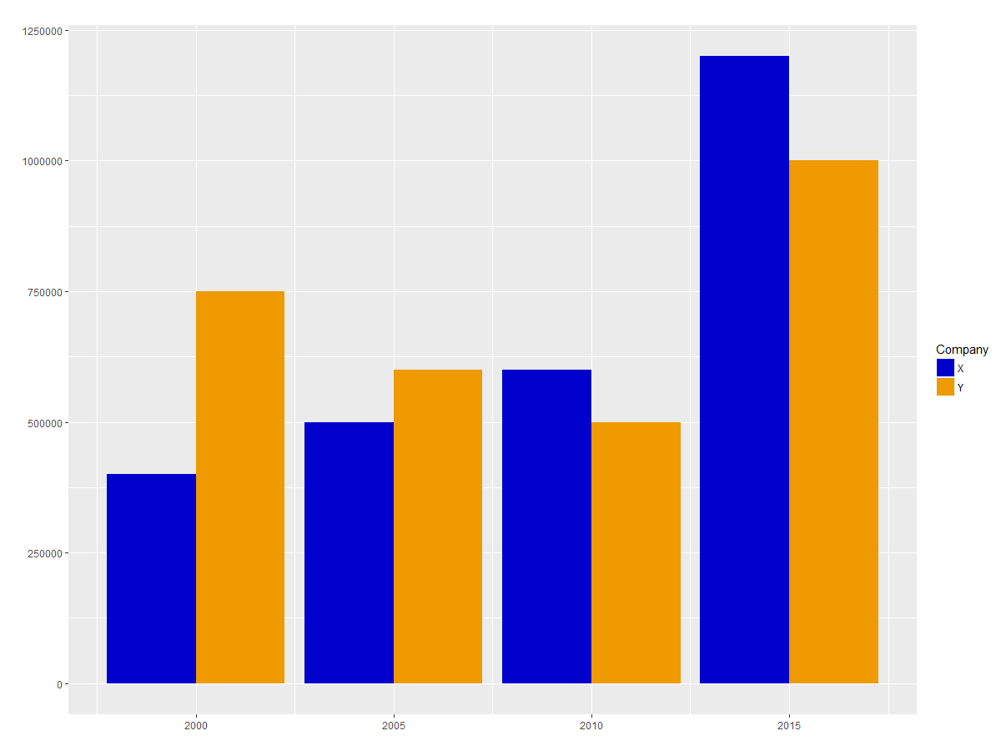
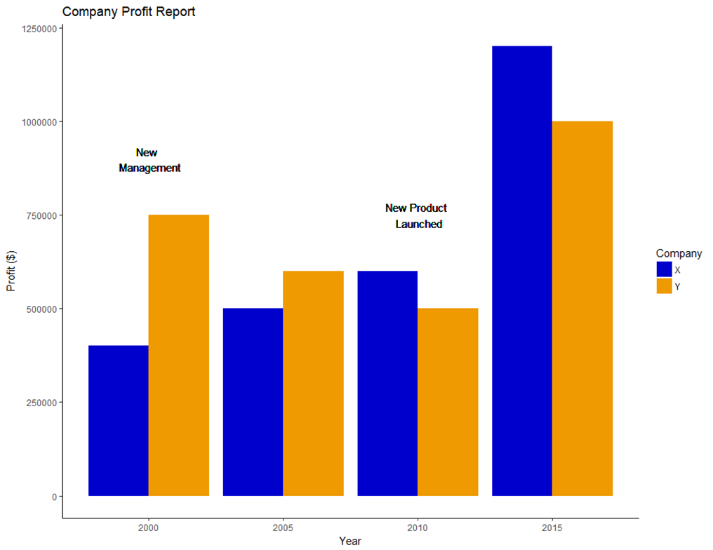
Best Practices
Layout Design
Title
Axes
Annotations
Themes
Colors
Use fewer than 6 colors
Use color opposites
Don’t Fight Established Norms
Scales, Distortion, Chart Types

Slide 47
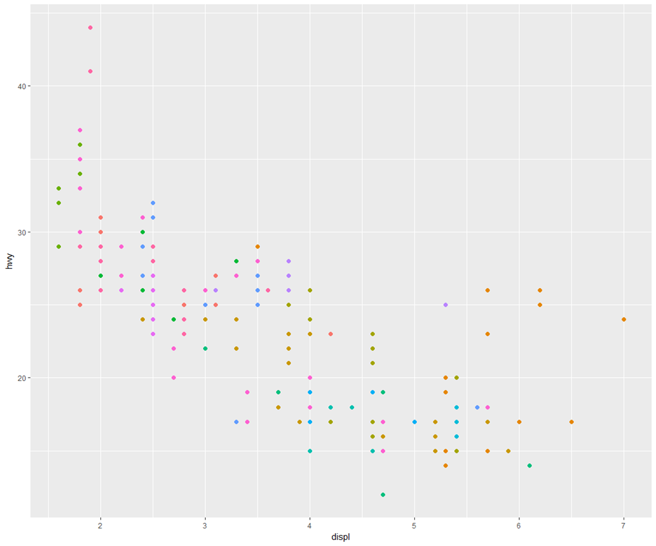
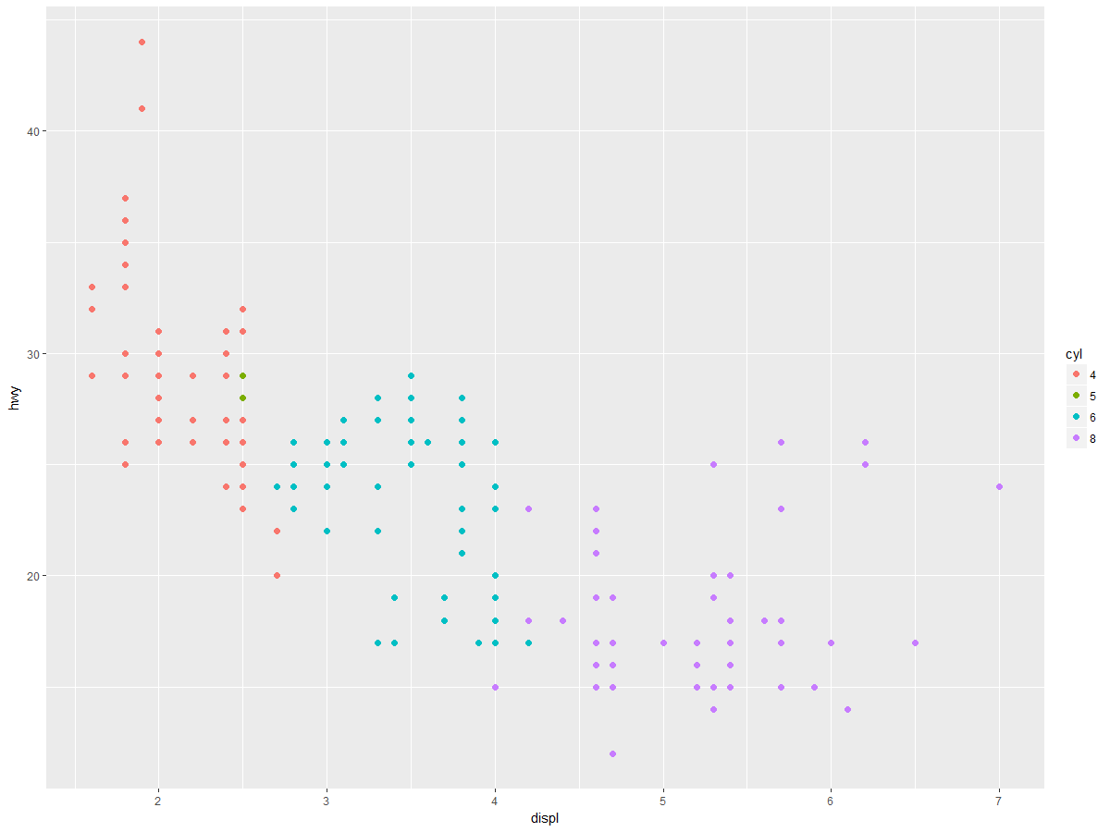
Best Practices
Layout Design
Title
Axes
Annotations
Themes
Colors
Use fewer than 6 colors
Use color opposites
Don’t Fight Established Norms
Scales, Distortion, Chart Types

Slide 48
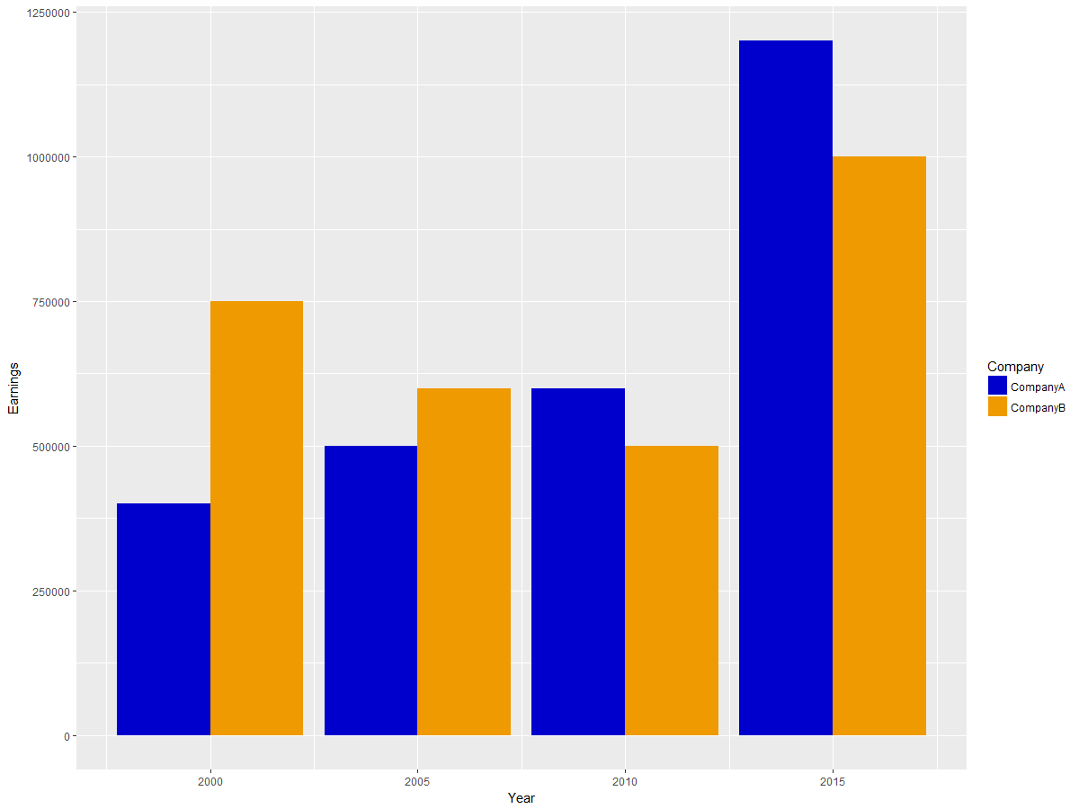
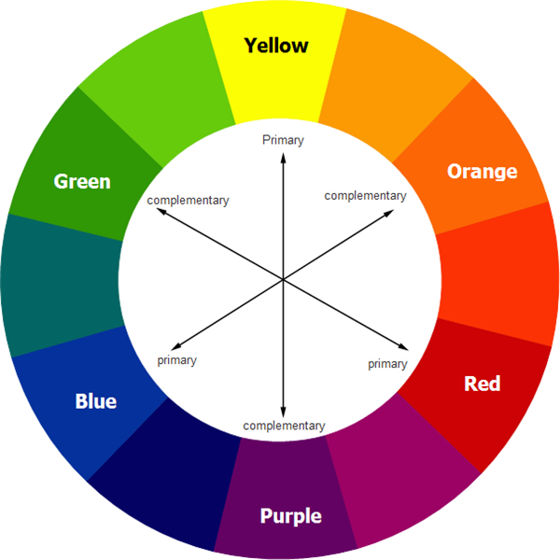
Best Practices
Layout Design
Title
Axes
Annotations
Themes
Colors
Use fewer than 6 colors
Use color opposites
Don’t Fight Established Norms
Scales, Distortion, Chart Types
www.edrawsoft.com/templates/pdf/color-wheel.pdf

Slide 49
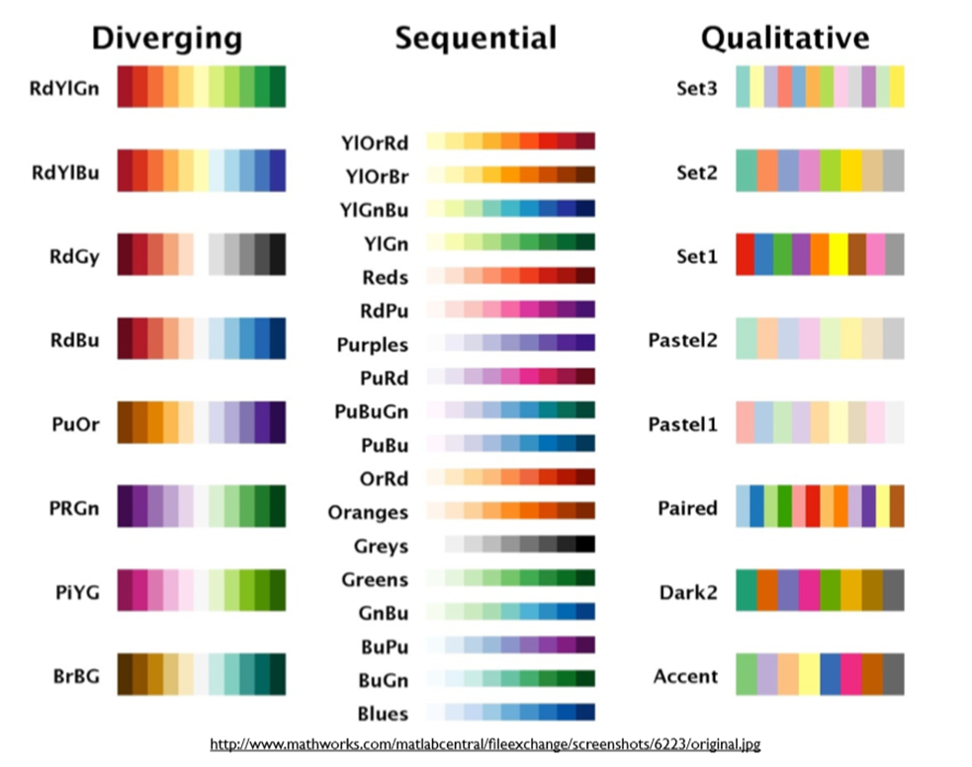
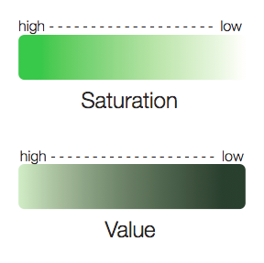
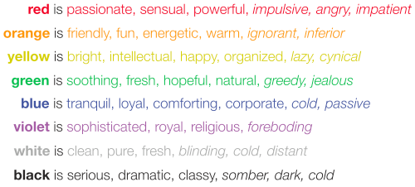
Best Practices
Layout Design
Title
Axes
Annotations
Themes
Colors
Use fewer than 6 colors
Use color opposites
Don’t Fight Established Norms
Scales, Distortion, Chart Types
https://socialh.com/choosing-colors-for-your-business-or-website/

Slide 50
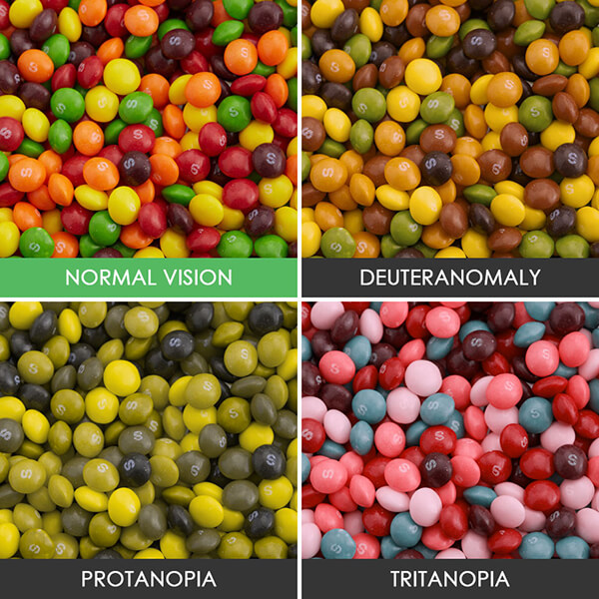
ADA Compliance
Red-Green
Deuteranomaly
Yellow and green appear redder
Difficult to tell violet from blue.
Most common affecting ~5% of males
Protanopia
Red appears as black.
Certain shades of orange, yellow, and green all appear as yellow.
Affects ~1% of males.
Blue-Yellow
Tritanopia
Blue appears green
Yellow appears violet or light grey
Extremely rare affecting males and females equally.

Slide 51
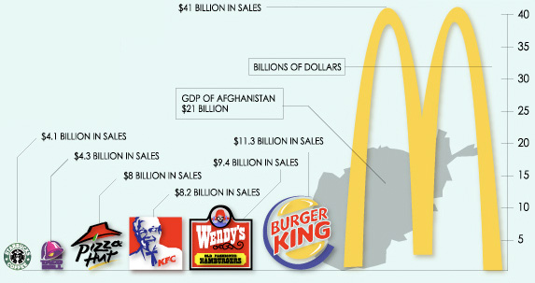
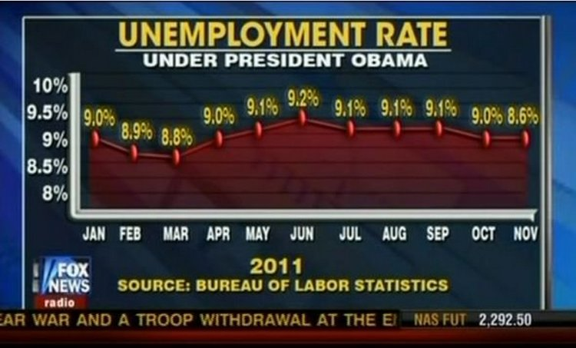
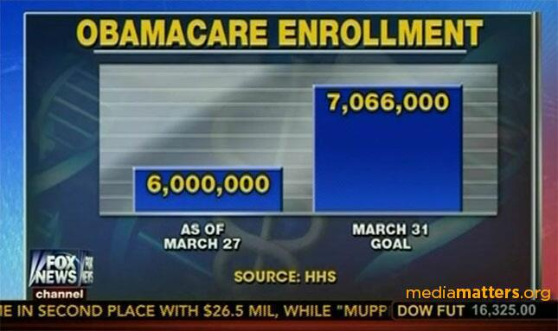
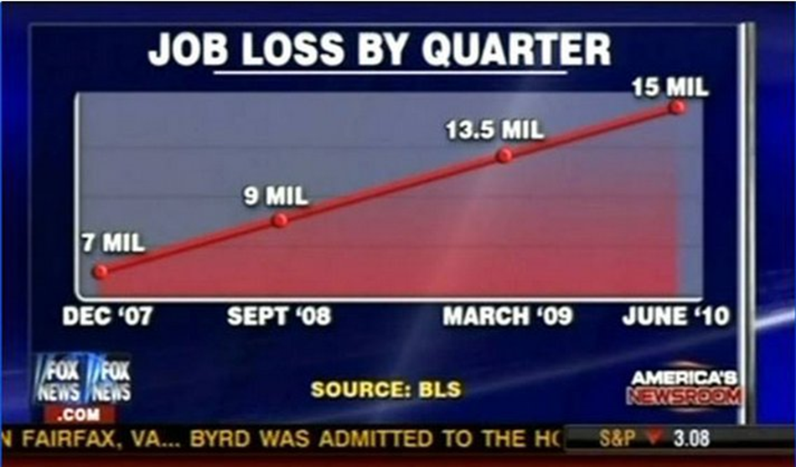
Best Practices
Layout Design
Title
Axes
Annotations
Themes
Colors
Use fewer than 6 colors
Use color opposites
Don’t Fight Established Norms
Scales, Distortion, Chart Types
http://www.businessinsider.com/the-27-worst-charts-of-all-time-2013-6
http://flowingdata.com/2014/04/04/fox-news-bar-chart-gets-it-wrong/
https://eagereyes.org/blog/2008/linear-vs-quadratic-change
http://www.businessinsider.com/the-27-worst-charts-of-all-time-2013-6

Slide 52
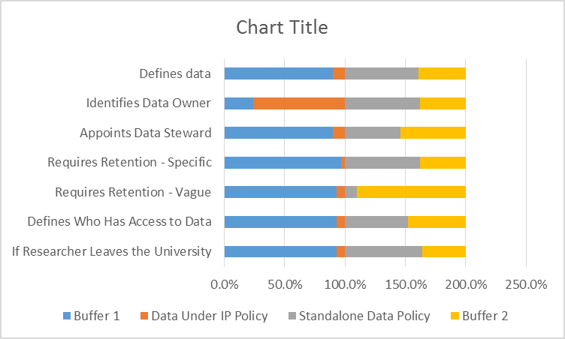
Real World Example
Data from: Briney, K., Goben, A., & Zilinski, L. (2015). Do You Have an Institutional Data Policy? A Review of the Current Landscape of Library Data Services and Institutional Data Policies. Journal of Librarianship and Scholarly Communication, 3(2), eP1232. DOI: http://doi.org/10.7710/2162-3309.1232
Notes:
I pulled some of my own data for this example, as I now cringe at looking back at the original chart (the paper’s Fig 5, which is open access if you want to see it - http://doi.org/10.7710/2162-3309.1232).

Slide 53
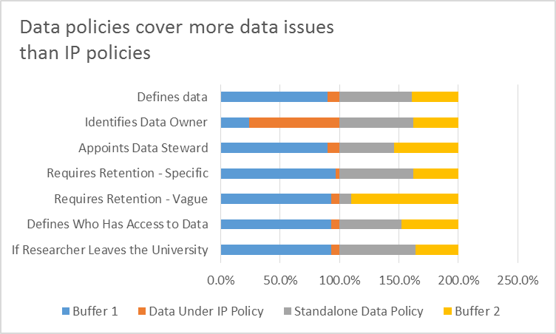
Start With Your Message
Write the main message as chart title
Subtitle can add further clarification

Slide 54

Highlight Only the Important Data
Pick 1-3 things to highlight or pick a different chart
Remember your message

Slide 55

Pick Good Colors
Use color sparingly/to highlight
Grey is your friend
Related things have related colors
Be consistent
Avoid
Pairing red and green (colorblind)
Pink for women, blue for men
Check: print in black and white!

Slide 56

Order Matters
Others don’t care about original order
Sort order visually
Caveats for time data, etc.

Slide 57

Eliminate Junk
Delete legends
Remove axis lines
Remove or trim axis numbers
Condense data categories
Eg. Positive and negative responses instead of 5-value Likert scale

Slide 58

Add Strategic Labels
Legend
Put series name right next to the data on the plot
Axis numbers
Label data directly

Slide 59
Before and After

Slide 60

Chart Improvement Steps
Start with your message
Highlight only the important data
Pick good colors
Order matters
Eliminate junk
Add strategic labels

Slide 61
Advanced Visualizations
Tableau
D3.js
https://public.tableau.com/en-us/s/gallery/march-madness
https://samples.dundas.com/Dashboard/c82402e9-02ab-49f5-ba90-33513c82020b?e=false&vo=viewonly
http://www.vizwiz.com/2017/12/help-desk-performance.html
https://public.tableau.com/en-us/s/blog/2016/12/readers-choice-top-5-vizzes-2016

Slide 62
Advanced Visualizations
Tableau
D3.js
http://mbostock.github.io/d3/talk/20111116/bundle.html
http://mbostock.github.io/d3/talk/20111116/airports-all.html
http://animateddata.co.uk/lab/d3-tree/
http://mbostock.github.io/d3/talk/20111116/iris-parallel.html
https://github.com/d3/d3/wiki/gallery

Slide 63
Additional Resources
Online Resources:
http://datavizproject.com/
http://flowingdata.com
http://www.dailyinfographic.com
http://www.informationisbeautiful.net
https://datavizcatalogue.com/
http://www.datacarpentry.org/
Grammar of Graphics (Hadley Wickham)
Future Workshops:
Introduction To Data Visualization in R with GGplot2
When: Thursday, June 21, 2018 From 1:00 PM to 2:30 PM
Where: CEAS Library - 850D Baldwin Hall

Slide 64
Questions?

